Slide 1
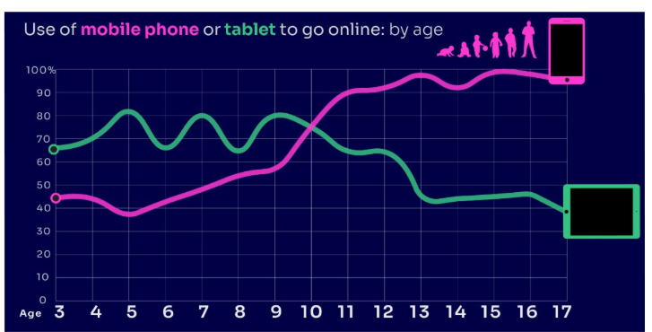


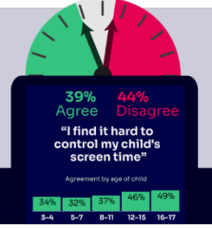


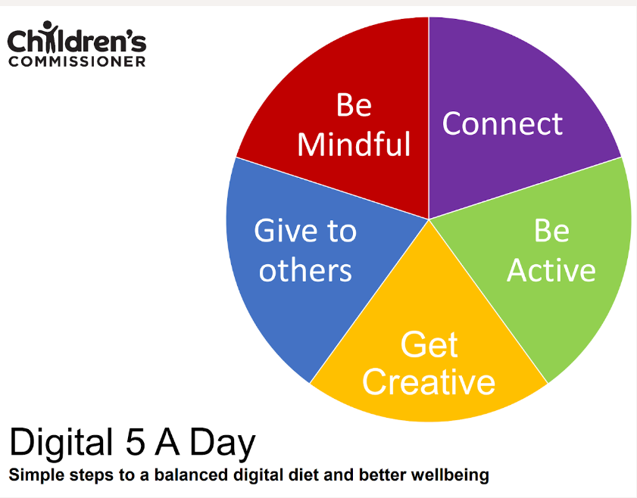

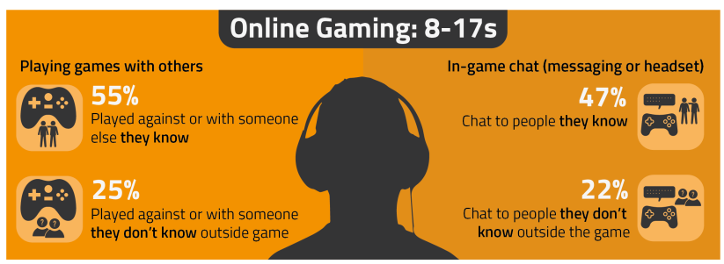

PARENT ONLINE SAFETY
NEW for 2025
Notes:
This presentation brings together:
- the latest research and key findings on children’s and young people’s online use and risk
- parents’ views about their children’s media use, devices and supervision to monitor or limit use
- suggested resources and tips to empower parents to keep up with the latest trends/apps and games, manage controls and settings, and talk to children about risk - from bullying and sharing content, to extremism and gangs

Slide 2

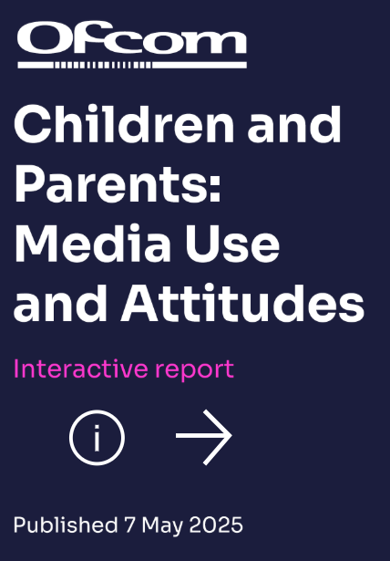





This presentation brings together:
Key Findings from:
  Children and parents: Media Use and Attitudes report
  Children’s Online User Ages 2025 Quantitative Research Study
  Children and parents: media use and attitudes report 2025 – interactive data
  IWF Annual Data & Insights Report 2024, published April 2025
  https://www.gambleaware.org/media/hbcp3qgd/exploring-the-lived-experience-and-views-of-gambling-among-children-and-young-people_final_0.pdf
  NSPCC (2024) Young people’s experiences of online sexual extortion or ‘sextortion’
  Internet Watch Foundation Annual Report 2023
  Evidence on pornography’s influence on harmful sexual behaviour among children Report 2023
  Revealing-Reality Anti-social Media Report 2023
Suggested Resources and Tips for Staff to help Parents/Carers:
  keep up with the latest trends, apps and games
  manage controls and settings
  talk to children about risk

Slide 3

What are you most WORRIED about when your child is ONLINE?
Notes:
Starter discussion
ASK: Find out what parents are currently worried about
TELL: Despite the positive finding that over seven in ten (72%) 8-17-year-olds who use messaging/social media sites or apps feel safe when using these apps/online sites, either all or most of the time, the online space is a risky environment for children.
Re-inforce thT the majority of parents / carers experience the same worries.

Slide 4


TALKING TO YOUR CHILD ABOUT LIFE ONLINE
Notes:
To use there is a distinct difference between the online and offline world.
However, for young people there is not, it is just ‘The World’.

Slide 5
YOU don’t need to be an EXPERT … be a PARENT
It’s your choice – don’t let others dictate when the right time is to use tech.
Stay involved – make time to communicate, talk about what they are doing. What do they enjoy? What makes them laugh?
Don’t quiz them – have regular conversations. What's their favourite app? What is the best site to learn new things from?
Join in – watch them play a game and join in. Who are they playing with? Do they know the other players?
‘Show me how…’ – ask their advice to help you with your privacy settings, who you should add as a friend, are there any risks?
Lead by example – children learn as much from watching as they do from being told not to do something, so model good behaviour
Reassure them – tell them that they won't get in trouble and that you are always there to help
Notes:
ASK – What do you do that works well? Share good practice
REMIND - You do not need to be a tech expert to help your child with staying safe online. It’s ultimately about communication and being proactive.

Slide 6
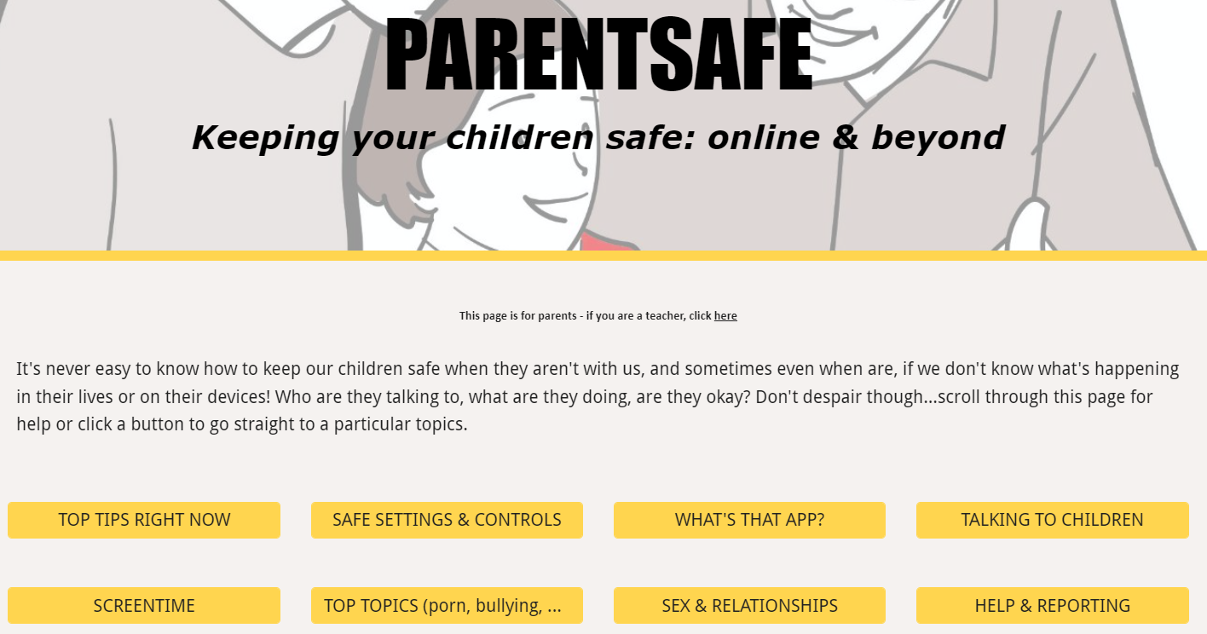
parentsafe.lgfl.net
Notes:
TELL - It's never easy to know how to keep our children safe, especially if we don't know what's happening in their lives or on their devices! Who are they talking to, what are they doing, are they okay? Don't despair though... We’ve created a dedicated website for parents and carers - simply scroll through ParentSafe for help or click a button to go straight to a particular topics. We will look at some of these resources and tips shortly

Slide 7
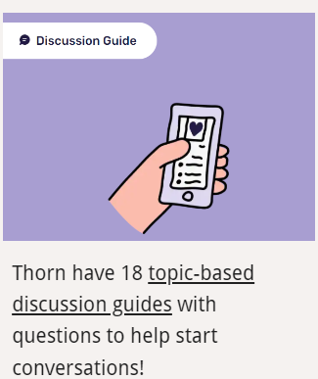




Find conversation starters, story time ideas and top tips to reinforce key safety messages at parentsafe.lgfl.net
Notes:
Feel free to point out some of these free resources for parents to reinforce safety messages and start those key online safety conversations:
TELL:
For younger children, it’s important to talk about boundaries, being kind to others and what they can do if they see or experience anything that worries or upsets them. Story time books e.g. ‘The Online Zoo’ and ‘#Goldilocks – a Fairytale for the Digital Age’ are great ways to discuss risk, consequences and positive strategies in a non-judgemental, age-appropriate way.
For older children, Thorn have 18 topic-based discussion guides with questions to help start conversations! Click on thorn picture to show website.
Agreement – we will look at more detail later…

Slide 8
DEVICE USE AND OWNERSHIP

Slide 9
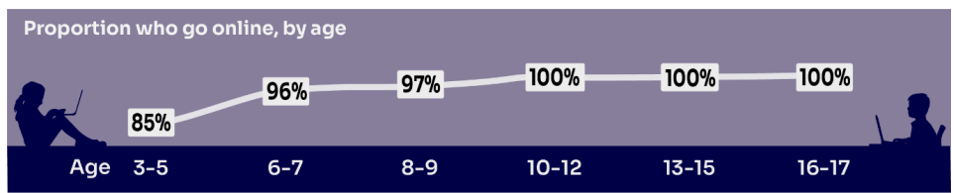
HOW MUCH DO YOU KNOW about your child’s life online?
Almost all children (96%) aged 3 – 17 went online in 2024, highlighting the centrality of the internet in their lives:
    Younger children commonly use tablets to go online
    Older children are more likely to use mobile phones
Source: Children and parents: media use and attitudes report 2025
Notes:
TELL:
We will be looking at 3–17-year-olds patterns of media use, how they access different sources of media online, and the types of online activities they are participating in. This includes their behaviours and habits in terms of viewing, playing, learning, and interacting
Almost all children from aged 5yrs (96%) went online in 2023, highlighting the centrality of the internet in children’s lives.
And we mustn’t forget that being online does create a lot of opportunity and joy for most of us. So, let’s think about how we can minimise risk and reduce their exposure to harm.

Slide 10
Does your child have their OWN MOBILE PHONE? If so, is it a SMART PHONE?
What AGE do you think is appropriate?
Source: Children and parents: media use and attitudes report 2025
Notes:
By the age of 11 nine in ten (91%) children aged 3-17 own their own mobile phone. in the period before they progress to secondary school, children become more likely to use a mobile phone to go online, while younger children (those aged 10 and under) are more likely to use a tablet.
TELL - A common debate is about the age at which children should be able to use smartphones. These are mobile phones that can access the internet and have apps installed on them. Some parents have opted for non-smart’ phones, which are mobiles that usually only have text and call capabilities.
It is your parental choice whether to get your child a smart phone or not.
Consider what the purpose of the children owning a mobile phone is and therefore which type they need.
However, if you are choosing to allow them a smart phone then it is your responsibility to set the boundaries to ensure that the children use it safely, respectfully and responsibly – must open up the conversation and be the responsible adult.

Slide 11

SMARTPHONE or ‘NON’-SMART / BRICK phone?
REMEMBER IT’S YOUR CHOICE
Every child and situation is unique,
and you are best placed to know their needs
Internet access
Social media, apps and games
Notifications
Anytime connection
Parental controls
NO internet access
Some games
Anytime phone calls and texts
Limited parental controls
Notes:
ASK THEM TO CONSIDER:
How will they reduce any risks?
What does their child need the mobile for? Is it simply to stay in touch with you - then a ‘non-smart’ phone might be enough. But if you want them to access homework or learning on their mobile, then a smartphone might be better.
How you can help your child learn the basic skills to use it safely e.g. to send a message, take part in a group chat, manage their timings etc. Children need our support with developing these skills. You wouldn’t give your child a knife without guidance and support, similarly a phone can cause harm and so need to think about this.
Whatever is decided, communication is key - involve the child in the process to establish shared expectations.
Remember to set up parental control settings or use a parental controls app to help them stay safe.
It is your parental choice whether to get your child a smart phone or not.
However, if you are choosing to allow them a smart phone then it is your responsibility to set the boundaries to ensure that the children use it safely, respectfully and responsibly – must open up the conversation and be the responsible adult.

Slide 12
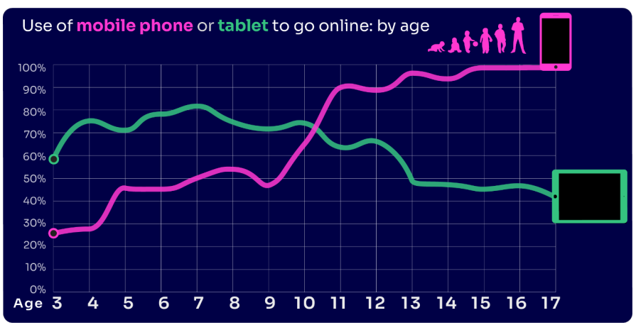
By age 11, nine in ten children own their own mobile phone, distinct from using a family device
This correlates with transition from primary to secondary school.
Source: Children and parents: media use and attitudes report 2025
Notes:
As in previous years, the point at which it becomes more likely that a child will go online using a mobile rather than a tablet closely correlates with the age at which mobile phone ownership among children becomes almost universal.

Slide 13
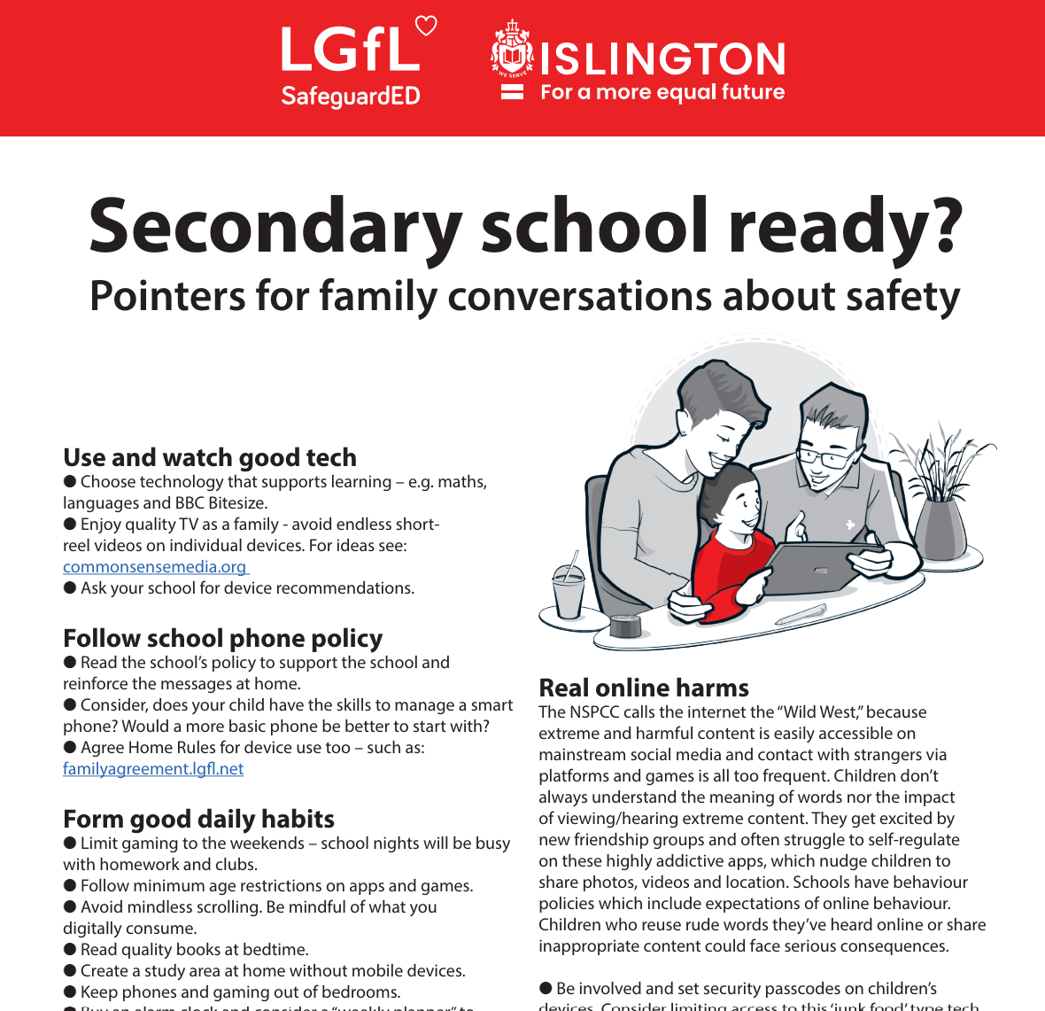
To help you with the transition of pupils from primary to secondary, why not download our FREE Leaflet for parents:
understanding risk
using tech for good
healthy habits and tips
when best to get a phone
Notes:
https://drive.google.com/uc?export=download&id=1-E_5IiDOfw3EQBPQgbGe9f2Qy3T7o_ny…
Take them through some of the key points from this leaflet on healthy habits and using tech for good
Although this leaflet is about secondary school ready – this does not mean it all starts in Y6. Some of this is important right from the start.

Slide 14
SUPERVISION AND PARENTAL CONTROLS

Slide 15
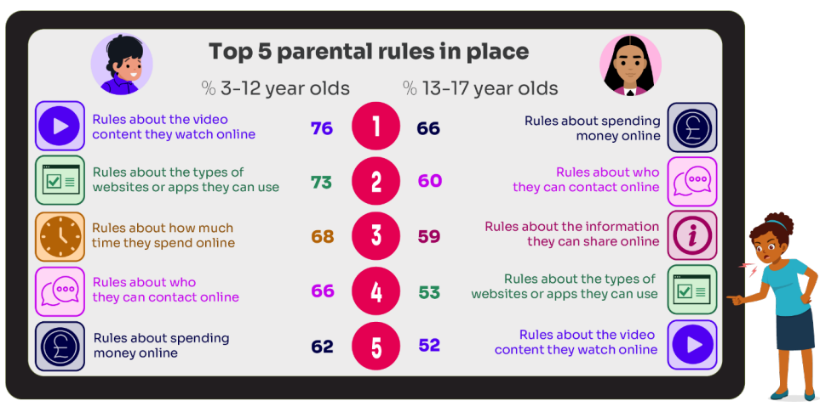
What RULES do YOU SET about being online?
What do you do that WORKS?
While parental concerns in some areas have increased considerably, their enforcement of rules appears to be diminishing, partly due to parents’ resignation about their ability to intervene in their children’s online lives.
Source: Children and parents: media use and attitudes report 2025
Notes:
ASK: What rules do you set for your children? How confident are you in implementing them?
This goes back to not needing to be an expert – just be a good parent!

Slide 16
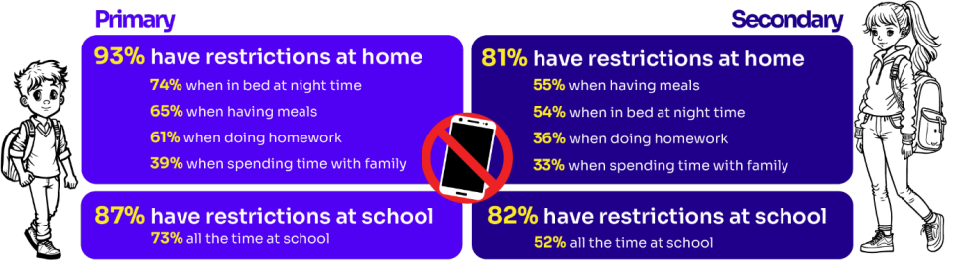
Do you RESTRICT their MOBILE PHONE USE?
If so, have you found it CHALLENGING?
Source: Children and parents: media use and attitudes report 2025
Notes:
ASK: What restrictions do you set for your children? How confident are you in implementing them?
More than eight in ten (83%) 8-17s in this group say there is at least one time when they cannot use their phones at home. Looking at specific restrictions when a child in this group is at home, nearly six in ten (58%) of 8-17s who go online via their phone say they are not allowed to use their phones when they are in bed at night, with a similar proportion (57%) reporting that they are not allowed to do so while having meals. Younger children in this group are more likely than older ones to report having each of these restrictions in place

Slide 17

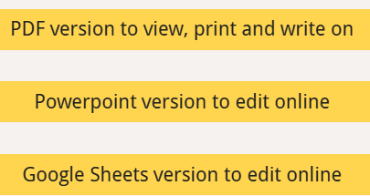
Why not have a family agreement to:
clarify what is allowed...or not
establish ground rules like no phones at the table or in the bedroom at night-time
agree shared expectations to reduce arguments and keep everyone safe & healthy
Download it at parentsafe.lgfl.net/digital-family-agreement
Notes:
TELL:
To help facilitate this, LGfL have created a free digital family agreement that parents could sit down and populate with all family members to agree what is and is not allowed within their family around tech use. This includes parents! YOU as parents also need to role model good behaviour.

Slide 18
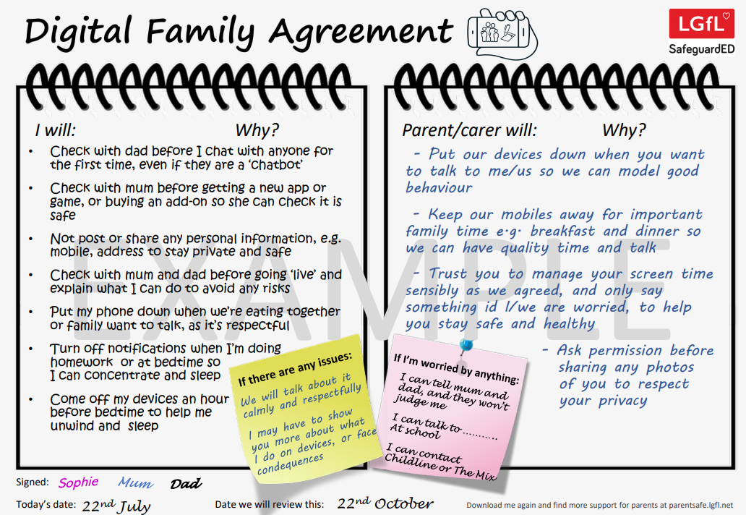
SHARENTING!
parentsafe.lgfl.net
Notes:
TELL - This is an example of a completed agreement – you may wish to take them through the sample statements to help them get started.
The digital agreement should be adapted to suit your family.
Be mindful that this needs to be done in collaboration and the children need to understand what everything means – don’t just present it to them, there will be no buy in.
Devices before bed interfere with the production of melatonin – the sleep hormone. - https://www.sleepfoundation.org/how-sleep-works/how-electronics-affect-sleep

Slide 19
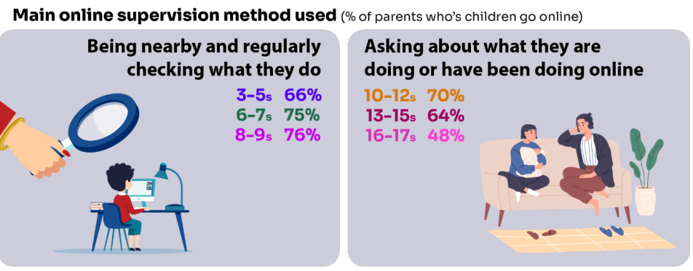
Do you SUPERVISE your child’s online activity? HOW?
Source: Children and parents: media use and attitudes report 2025
Notes:
We have talked about restriction and now we are looking at supervision – these are the two main ways of ensuring children are safe online.
TELL - The two most commonly-employed types of parental supervision among parents of 3-17s are to:
ask their child about what they are or have been doing online (59%), and
be nearby and regularly checking what their child does (55%).
Of course, this varies as the child gets older and more independent, as parents decreasingly monitor their child’s online life

Slide 20

Have you set up parental CONTROLS/PRIVACY SETTINGS for ALL DEVICES and NETWORKS?
Controls need to be set up on both the broadband connection AND each individual device
These do not come as standard so it’s worth checking
They are important because they allow you to:
  Block and filter upsetting or inappropriate content or sites
  Plan what time and how long your child can go online for
Notes:
To further support restriction and supervision strategies in place parental controls / privacy settings need to be set up.
TELL – it is important that these controls are set up on BOTH the broadband connection AND each individual device
About seven in ten (73%) parents of all 3-17-year-olds use at least one type of technical tool or control to manage their child’s access to online content; parents of 8-11-year-olds are more likely than those of older children to use at least one of these tools (84% vs 70% of parents of 12-15s and 54% of parents of 16-17s respectively). The most commonly-used technical tool used, across all parents of 3-17s, were parental controls built into the device by the manufacturer, e.g. Windows, Apple, Xbox, PlayStation etc. (32%). (Ofcom 2024)

Slide 21
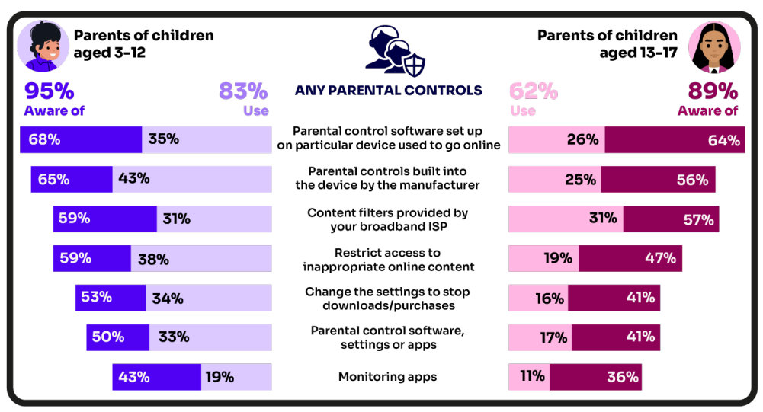
Are you AWARE of these PARENTAL CONTROL TOOLS?
Which ones have YOU USED?
‘I prefer to supervise my child’s online use by talking to them about setting rules’
(39%)
Source: Children and parents: media use and attitudes report 2025
Notes:
There is a high awareness of technical control tools among parents, BUT many are choosing not to use them
This has improved with recent data.
Still a few are choosing not to use anything - Is this because they don’t know how or choose not too.
ASK – Why do you think this is the case?
TELL – it’s not as complicated or scary as you think. Let’s look at some top tips and resources to support you.

Slide 22
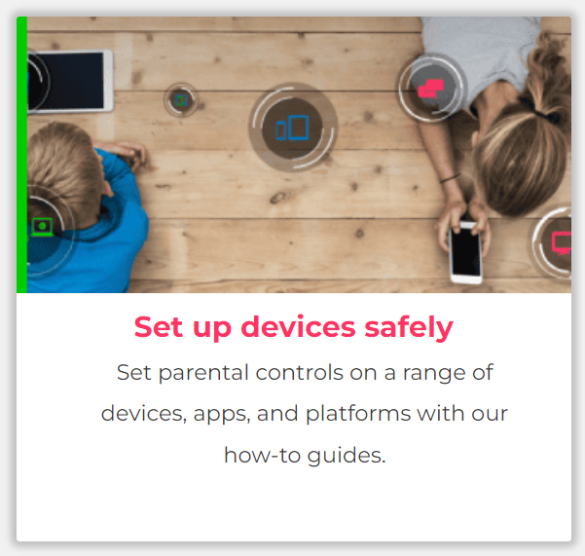
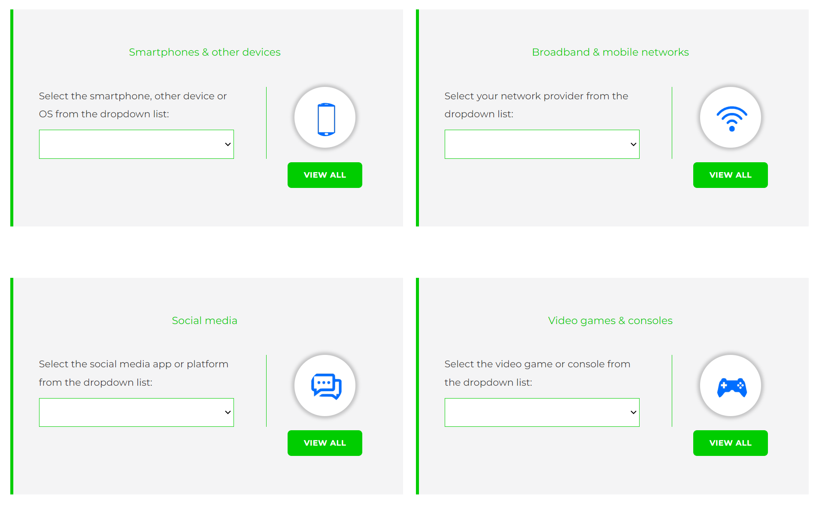
Visit internetmatters.org/parental-controls to find out how to set controls on devices:
Notes:
TELL – They can use this great page to find out how to set up controls on any smartphone, broadband, social media site/app and games console
REMIND - They need to set up parental controls on each of these individually
Demo example by following the link

Slide 23
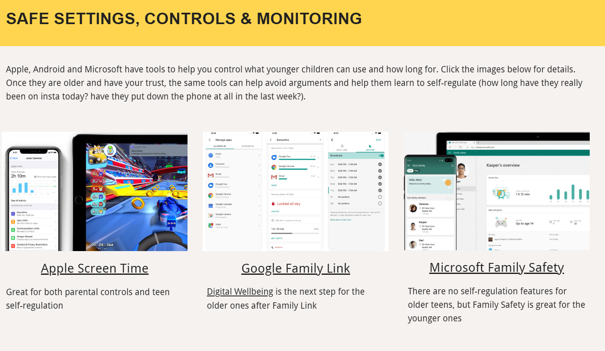
Parental control apps like Google Family Link, Screen Time and Microsoft Family can let you set limits across devices, apps and platforms
Visit parentsafe.lgfl.net/ for additional advice and tips on settings and controls for all devices
Notes:
EXPLAIN - As well as setting controls on your broadband, device, apps, games etc, Parental Control Apps like Google Family Link, Screen Time and Microsoft Family can further enhance safety by letting you set limits across devices, apps and platforms without needing to access these spaces separately. You can manage screen time, app access, inappropriate content restrictions and more.
Screen Time shows you how much time you spend on apps, websites and more. You can also set limits and restrictions for what you want to manage – on your own device or a child's device.
Family link can run on Android devices, e.g. Samsung… Parents can access and manage their child’s account and settings, and delete it if necessary
TIP – Why not run a ‘Bring your device and we’ll show you….’ pupil-led workshop to help parents with this at school?

Slide 24

REMEMBER
As children get older, restrictions and controls you use will change, but only at a pace you feel is appropriate for your child, not pressure from your child “because everyone else is allowed”
Content filters are never 100% effective, at some point your child may come across inappropriate or upsetting content, so make time to talk regularly

Slide 25
SCREENTIME

Slide 26
Screentime
Device Free Dinner - https://www.commonsensemedia.org/videos/devicefreedinner-attention-funny-or-die
Lots of parents worry about it, but rather than worry about how long your child is online, consider what they are doing and when they are doing it (and the same goes for grown-ups)
Not all time spent online is equal. A video call to a family member or learning a new skill is very different to hours of doom scrolling or passively consuming short-reel content.

Slide 27
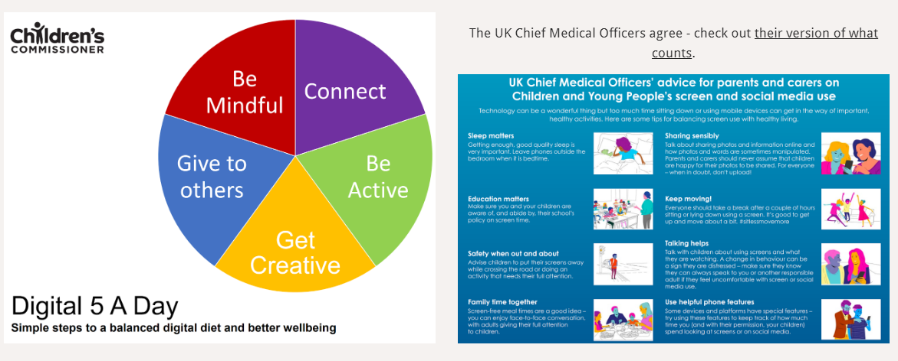
Visit parentsafe.lgfl.net/ for advice and tips to manage screentime
Notes:
TELL – It’s not necessarily how long they are online but what and when they are doing that counts - take them through the UK Chief Medical Officer’s advice poster above for examples
EXPLAIN – the Digital 5 A day gives children and parents easy to follow practical steps to achieve a healthy well balanced digital diet, by encouraging them to reach of the targets in the pie chart – share some examples with them https://www.childrenscommissioner.gov.uk/digital/5-a-day/
Don’t worry about screen time; aim for screen quality

Slide 28
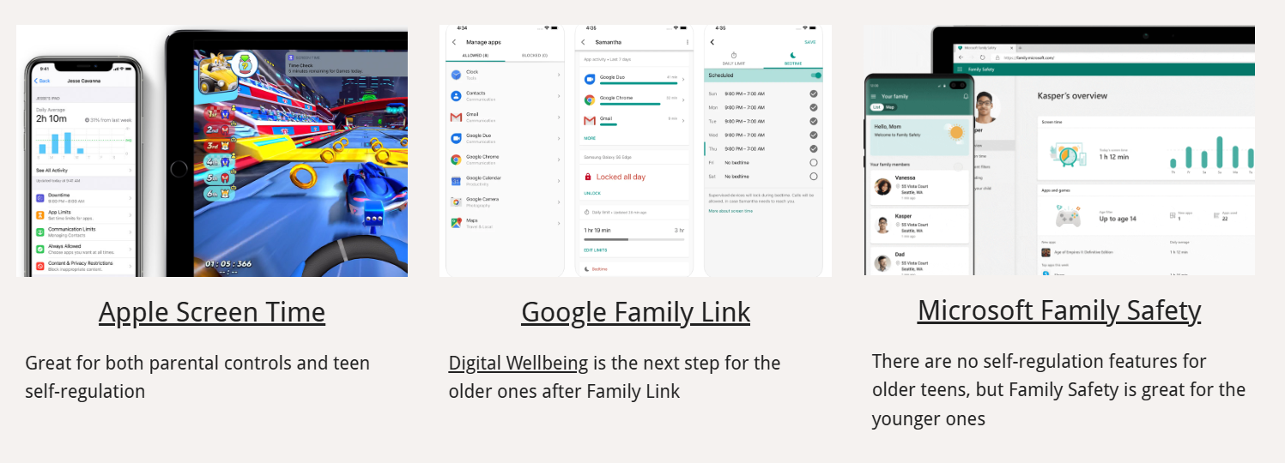
Notes:
You can use these to control settings to regulate screen time in general and on specific apps,
As they get older it is about helping them learn to self-regulate (how long have they really been on insta today? have they put down the phone at all in the last week?).

Slide 29
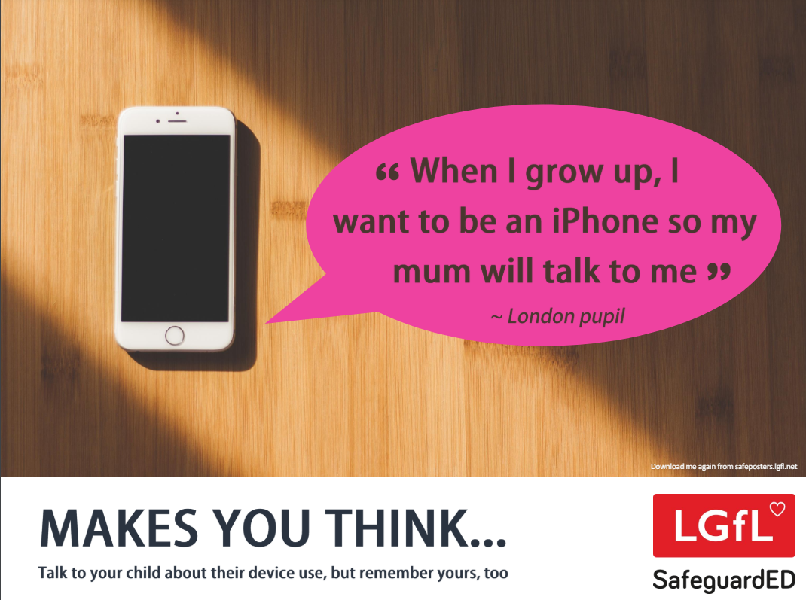
How does your child feel about YOUR SCREENTIME vs THEIRS?
52% of 8-11s feel that their parents’ screentime is too high
33% of 8-17s feel that their own screentime is too high
Source: Children and parents: media use and attitudes report 2025
Notes:
Of the third of online 8-17s who think their screentime is too high, just over half (52%) also think their parents’ screentime is too high, compared with the 15% who do not think their parents screentime is too high, and a quarter (26%) who are not sure.
REMIND – it’s important to model good behaviour when it comes to device use, as children will follow our example.

Slide 30
SOCIAL MEDIA AND GAMING

Slide 31
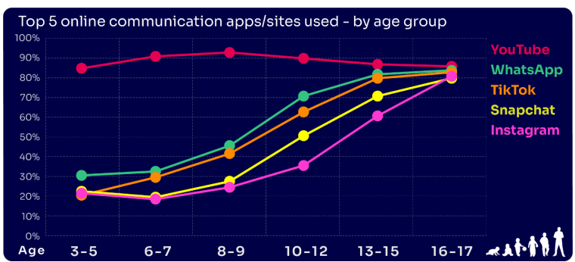
Are you FAMILIAR WITH THE APPS and GAMES your child is on?
YouTube is the most popular, but the appeal of many social media platforms varies by age
The two most popular apps for 3 – 7 yr-olds are WhatsApp (2 in 10) and Snapchat (3 in 10)
The proportion of 8-9s with an Instagram profile increased from 8% in 2023 to 14% in 2024
13-17s are most likely to have profiles on WhatsApp
(62%), Snapchat (62%) or TikTok (61%)
Go to apps.lgfl.net for guidance on apps and social media sites
Source: Children and parents: media use and attitudes report 2025
Notes:
YouTube continues to be universally popular, and the appeal of other social media platforms increases with age . nearly half (48%) of 16-17s use all of the top five apps/ sites that we asked about (YouTube, WhatsApp, TikTok, Snapchat and Instagram).
REMIND – your children need to be 13+ to use these platforms (See slide 39)
Remember by the time you have an account on one of these accounts the children have moved onto the next thing!

Slide 32
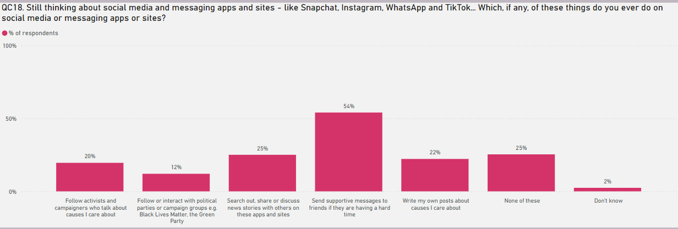
KNOW WHAT THEY DO on social media?
Eight in ten (81%) of all children aged 8-17 use at least one social media app/site for following friends, people and organisations, reading, liking or sharing content
TikTok was the most favoured platform to message and communicate with friends.
Source: Children and parents: media use and attitudes report 2025
Notes:
TELL - Motivations for using these types of app vary, but a key reason is the desire to connect with peers. Seven in ten (68%) 8-17-year-olds who use social media and/ or messaging sites or apps told us that using these types of sites or apps helped them feel closer to their friends, either all or most of the time.

Slide 33

WHY DOES THIS MATTER?
Young people can get around age restrictions on apps and websites, increasing the risk of them coming to harm online
Addictive algorithms can make it harder to take a break and maintain a healthy balance between time on and offline
Algorithms can also target content similar to what you’ve already selected/liked/shared
This can prevent you from finding new ideas and perspectives, create misinformation and reinforce stereotypes
Notes:
ASK – What kinds of risks do you think children could be exposed to? Can you give examples? (See slide 48 for a summary of related risks)

Slide 34
What might they NOT BE TELLING YOU?
Nearly six in ten (56%) 8-17s use multiple profiles on at least one social media platform:
(23%) said it was because one account was just for parents/family to see
15% said one account was for the ‘real me’ and another contained edited/filtered posts or photos
Source: Children and parents: media use and attitudes report 2025
Notes:
TELL - This demonstrates that at least some children feel the need to present distinct aspects of themselves on social media, depending on the audience.

Slide 35
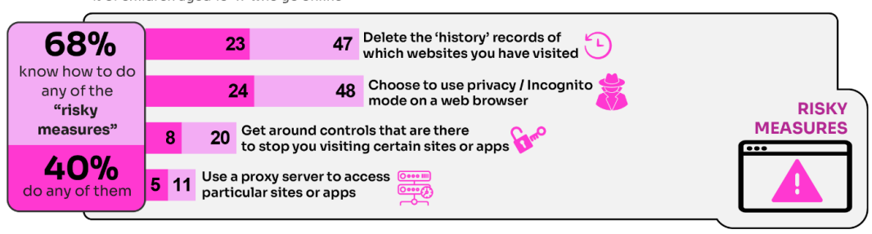
WHY is this ‘RISKY’?
40% had engaged in ‘risky’ behaviour!
Source: Children and parents: media use and attitudes report 2025
Notes:
TELL - This behaviour is considered ‘risky’ because they enable the child to conceal their online activity, preventing a parent or appropriate adult to ensure they are keeping safe online.
A proxy server acts as an intermediary, or "middleman," between your device (like a computer or phone) and the internet, intercepting your requests to websites and servers on your behalf, hiding your real IP address, and providing benefits like security, privacy, and content filtering

Slide 36
What about WHATSAPP?
Do you know the minimum age to use this? What are the risks?
Unwanted contact | to contact somebody on WhatsApp, all you need is their phone number, which could expose you to unwanted messages or calls
Inappropriate content | messages are end-to-end encrypted which means that the content cannot be monitored. This means that your child could see or hear harmful or upsetting content e.g. pornography or violence.
Location sharing | live location feature means that your child could reveal their current location to others
Cyberbullying | children could be bullied, feel left out or deliberately excluded or removed from groups
Oversharing | privacy features, such as disappearing and ‘view once’ messages, might mean that your child feels safe to reveal private or risky information or images. However, there is always a risk that this could be copied and shared
Notes:
TELL - WhatsApp let users send messages and content to contacts added to their account. To use the service in the UK, users must be 13-years-old or older (as of April 2024. The minimum age for WhatsApp used to be 16)

Slide 37

https://youtu.be/BpT8vFn6_eA
Notes:
PLAY – ‘What's Up on WhatsApp? Group Chats and Kicking’ video showing primary pupils talking about the realities of group chats and exclusion bullying - deliberately being left out to hurt someone's feelings.
https://youtu.be/BpT8vFn6_eA

Slide 38
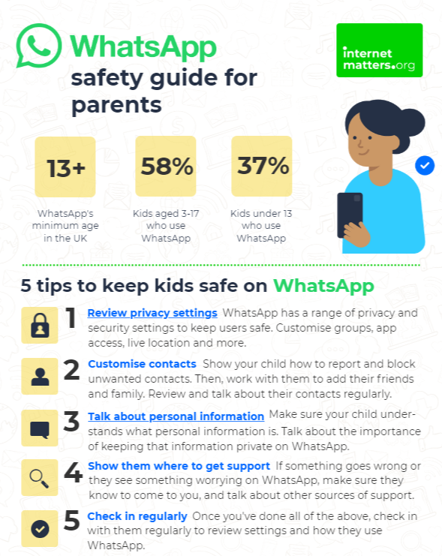
What can you do?
Visit https://www.internetmatters.org/resources/whatsapp-safety-a-how-to-guide-for-parents/#whatsapp-safety-tips for advice for parents
Notes:
SHARE – 5 top tips from the parent safety guide at https://www.internetmatters.org/resources/whatsapp-safety-a-how-to-guide-for-parents/#whatsapp-safety-tips
EXPLAIN – it’s useful to talk with children about etiquette when using group chats e.g.
how to communicate
what language to use/not use
recognition that others may see your messages if copied and shared
what to do if someone is unkind to them or others etc.

Slide 39
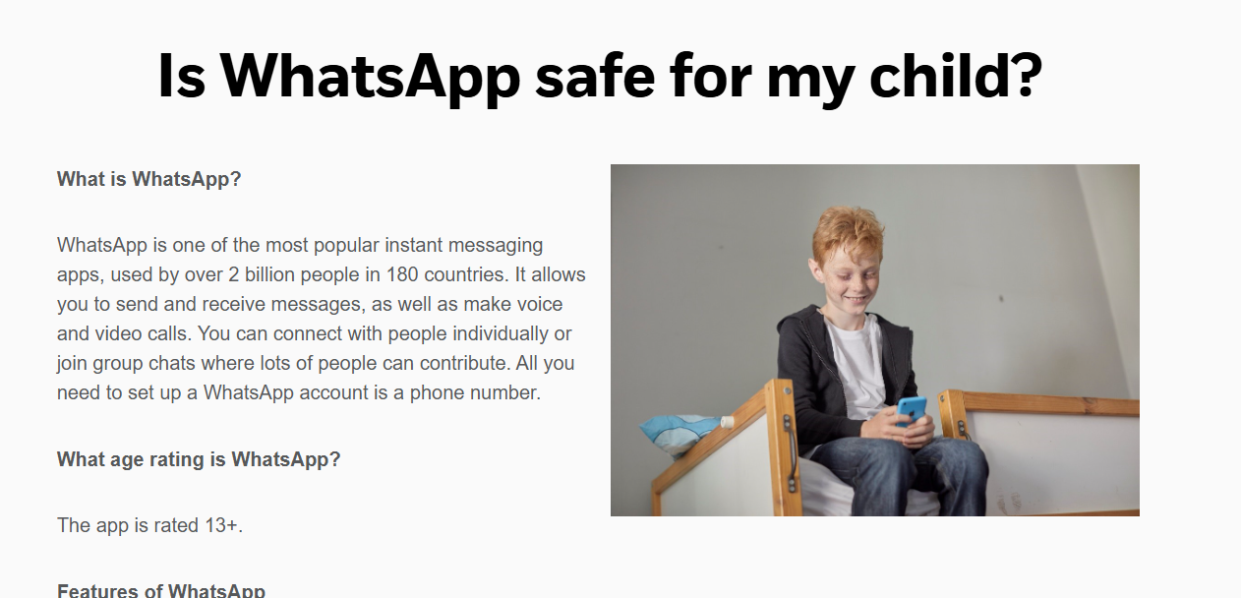
What can you do?
Visit https://www.nspcc.org.uk/keeping-children-safe/online-safety/online-safety-blog/2023-01-12-is-whatsapp-safe-for-my-child/ / for advice
Notes:
Another article that may be useful.

Slide 40
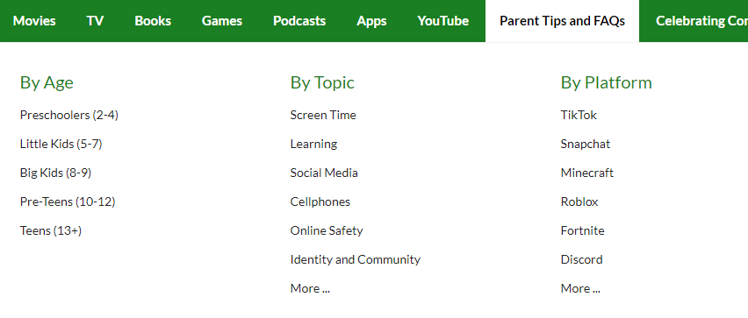


Find ratings and reviews for parents on apps, games and social media at commonsensemedia.org
Notes:
REMIND – they don’t need to be experts, but they can empower themselves by finding out about the suitability of the games/apps their child uses
SHOW – the Common Sense Media page and pick an app or game to show how easy it is to find a review

Slide 41
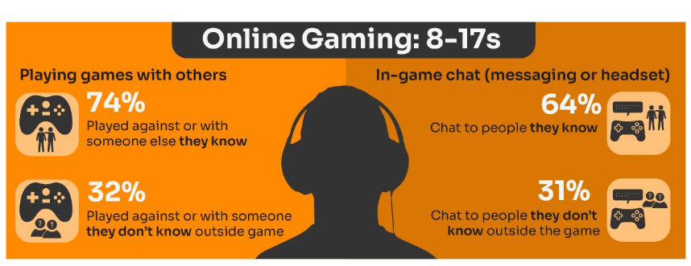
Do you know the DIFFERENCE between an ‘ONLINE’ FRIEND and a real one? How does this differ from your CHILD’S VIEW?
Are you familiar with who they are in contact with whilst playing games?
Have you asked about the chat facility?
Do you know the content and age restrictions for these games?
72%
63%
31%
31%
Visit gaming.lgfl.net for advice and activities
Source: Children and parents: media use and attitudes report 2025
Notes:
TELL:
Children often use online gaming as a tool to communicate with their peers, with 64% of 8-17s who game online chatting through the game with friends and/or people they know in real life.
However, 31% of children who game online, communicate with strangers as well.
A higher proportion of these children now play shooter games. This may raise concerns about how age appropriate the games favoured by some younger children actually are.
While communication via games is a valuable social tool for many children, it can sometimes leave them vulnerable to unwanted interactions. This year (12%) of all children aged 8-17 said someone had been nasty/hurtful to them through an online game

Slide 42
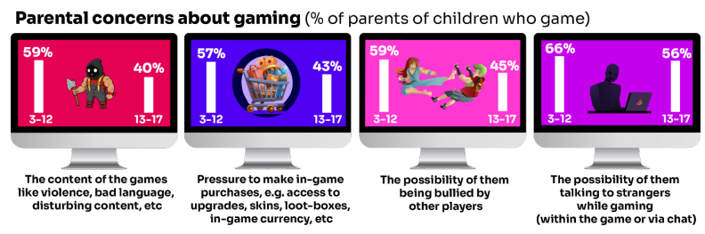
What are YOU most WORRIED about when it comes to GAMING?
Visit gaming.lgfl.net for advice and activities
Source: Children and parents: media use and attitudes report 2025
Notes:
TELL:
The most commonly cited concern among parents of 3-17s whose child games was the possibility of their child talking to strangers while gaming, either within the game or via the chat function (62%).
This was followed by the possibility of their child being bullied by other players (54%), the content of the games the child plays – i.e. violence, bad language, disturbing content etc. (52%), and the pressure on the child to make in-game purchases e.g. for things like access to upgrades, skins, loot-boxes, in-game currency or other rewards (52%).
Overall, parents of younger children are more likely than parents of teenage children (13-17s) to be concerned about these possibilities

Slide 43

Research finds children’s online spaces “saturated” with
GAMBLING-like content and advertising:
“They make it look like a game, it does not look like gambling.”
Risks are not understood by children due to the blurred lines between gambling and gambling-like activity such as loot boxes
Do you DISCUSS THIS when you talk about MONEY to your children and how gambling is made to LOOK ATTRACTIVE and likely that you would WIN?
https://www.gambleaware.org/media/hbcp3qgd/exploring-the-lived-experience-and-views-of-gambling-among-children-and-young-people_final_0.pdf
Notes:
TELL: The report found that gambling was understood to be a normal part of everyday life, and children described it as a part of their experience of growing up. Gambling content was seen with things such as horse racing, scratch cards and the National Lottery, while content that felt like gambling was seen in online games with gambling-like features such as loot boxes. The bright, loud and eye-catching nature of gambling adverts drew children and young people in, and many reported that gambling could look like gaming and vice versa, and the look and feel of the two worlds felt interchangeable.
EXPLAIN: Anyone who plays video games will probably have heard about loot boxes. They can contain useful items, in-game currency, new clothing or even characters that could change the way you play. 9 in 10 young people report that loot boxes are available in the games they play. A common practice if a game includes loot boxes is that the game is free. Typically, the game will make their money from selling tempting items in these boxes through a range of tactics –
ASK: Do you DISCUSS THIS when you talk about MONEY to your children and how gambling is made to LOOK ATTRACTIVE and likely that you would WIN?

Slide 44
How can YOU GET INVOLVED?
ASK what type of games your child enjoys – are they age-appropriate?
PLAY games together - keep the tech in shared spaces rather than bedrooms
TALK about who they are playing with - what information are they sharing?
EXPLAIN what is/isn’t appropriate to share, e.g. personal details to identify them/location
AGREE how they will spend their money online
DISCUSS what they would do if they were bullied online, and what steps to take
DECIDE how long is appropriate to play in one session - how many sessions a day
SETUP these restrictions in parental settings with your child
Visit gaming.lgfl.net for advice and activities to keep them safe

Slide 45
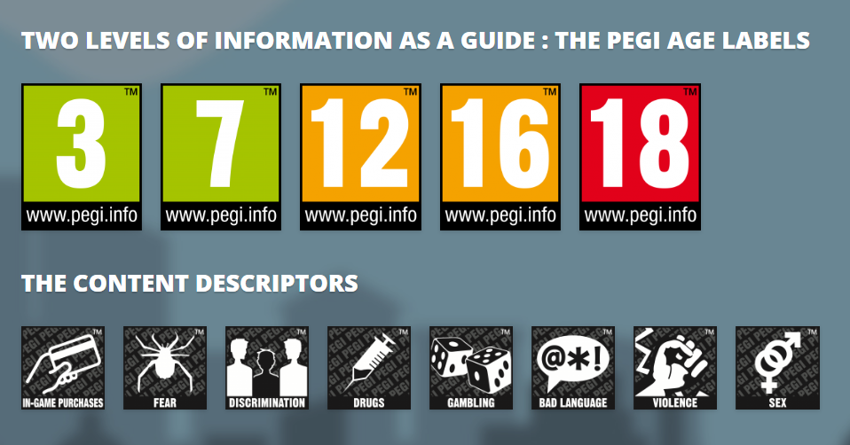
PEGI helps parents to make informed decisions when buying video games:
The age rating confirms that the game content is appropriate for players of certain age
It considers the age suitability of a game, not the level of difficulty
pegi.info
https://parentzone.org.uk/article/pegi-games-ratings#:~:text=The%20UK%20uses%20the%20PEGI,about%20how%20PEGI%20classifies%20games
Notes:
UK uses the PEGI (Pan European Game Information) system to give games their age ratings to help people make informed decisions when buying video games or apps through the use of age recommendations and content descriptors. .You can find out more here: https://parentzone.org.uk/article/pegi-games-ratings#:~:text=The%20UK%20uses%20the%20PEGI,about%20how%20PEGI%20classifies%20games.

Slide 46
STAYING SAFE ONLINE AND REPORTING

Slide 47
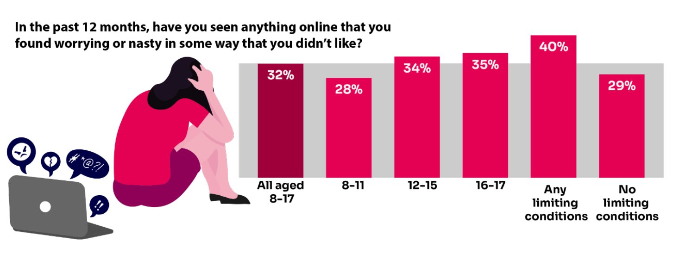
Summary of children’s negative experiences:
BUT Only 20% of parents report their child telling them about this in the same time frame.
Source: Children and parents: Media use and attitudes report
Notes:
TELL:
A third of 8-17-year-old children are being exposed to content online that they find worrying or nasty, but only 20% of parents report their child telling them they had seen something online that scared or upset them in the same time frame.
The likelihood of children seeing this type of content increases with age - just over a third of 12-17s say they have been exposed to this type of content in the past year (34%) compared to 28% of 8-11-year-olds.
NB. Children aged 8-17 who live with at least one impacting condition (e.g. illness, disability, SEND) are more likely than those without such a condition to say they have seen this type of content (40% vs 29%). This indicates that particular groups of children may be more vulnerable than others to being exposed to potentially harmful content.

Slide 48
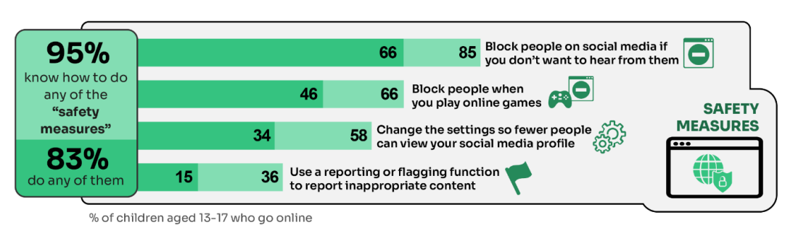
What do YOUNG PEOPLE do to STAY SAFE ONLINE?
Only 15% had used a reporting or flagging function
(36% were aware of these functions)
Go to reporting.lgfl.net to find out how to remove content from social media and where to report bullying, racial hatred, terrorism, sexual abuse and more
Source: Children and parents: media use and attitudes report 2025
Notes:
TELL - It is positive that children generally know about safety measures, but there seems to be a gap in their knowledge about reporting and putting the knowledge into practice.

Slide 49
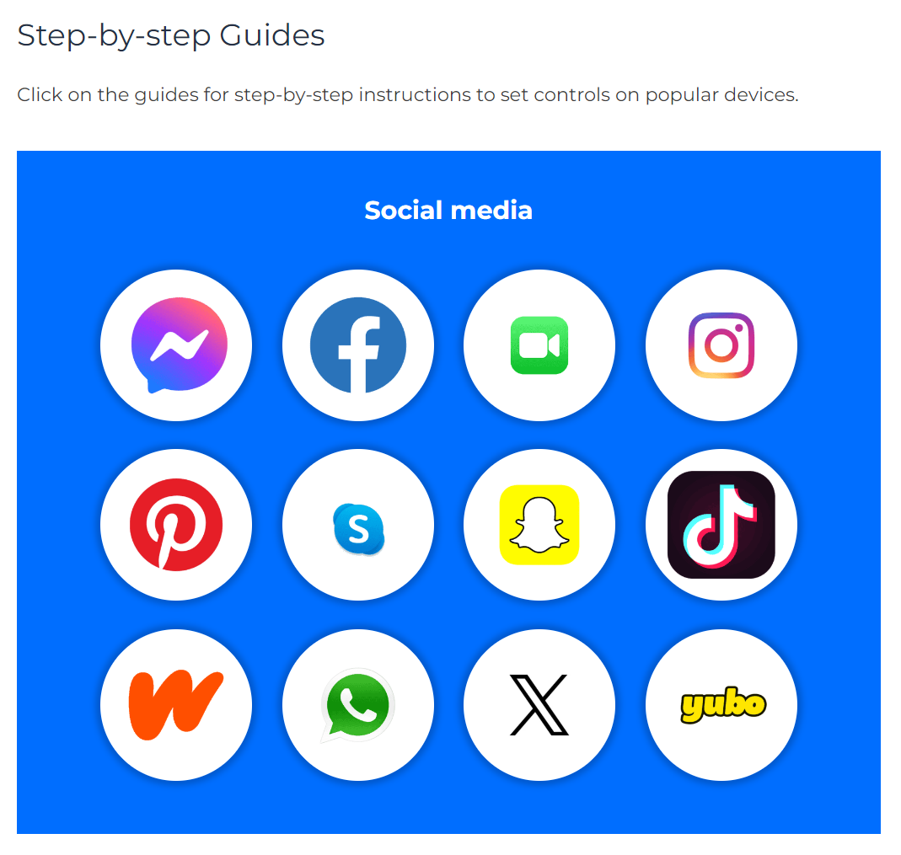
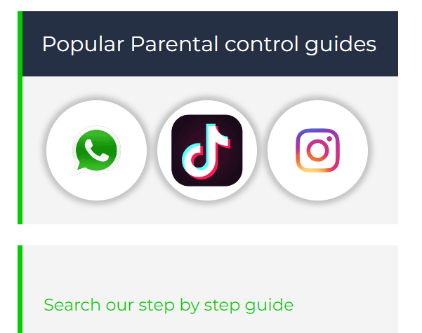
Do YOU know HOW TO REPORT to apps / sites?
Internet Matters has helpful guides for social media apps and sites at internetmatters.org/parental-controls/social-media
Notes:
Each social media site has it’s own processes for reporting inappropriate/harmful content.
Some reset when updated!

Slide 50
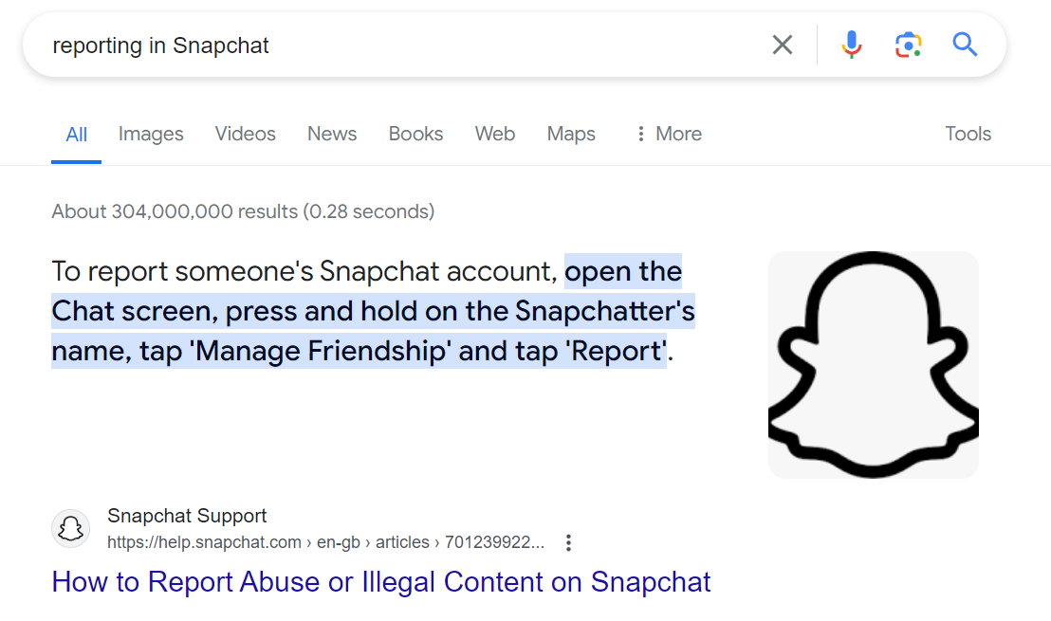
A simple Google search with the site name, e.g. ‘reporting in Snapchat’ will bring up the steps to take and signpost to the reporting page
Notes:
TELL – you can also do a Google search by typing ‘reporting in______________________________ (name of platform)’

Slide 51
Remember!
Before signing up to any app/site
check that your child meets the minimum age requirement
Remind your child to be cautious about accepting friend requests:
a real friend is someone they/you know in real life, not a ‘friend’ they met gaming or in a chat room.
Stress the importance of not sharing personal information with online ‘friends’
Keep passwords confidential
Check their privacy settings
emphasise the importance of not sharing personal information with strangers
Report any content
e.g. a post, image or harmful, misleading or damaging comment
Reporting doesn't guarantee immediate removal
platforms assess reported content based on their rules and policies

Slide 52



REVIEW
Step away.
Tell a trusted adult.
OK sites first.
Pause and think online.
Notes:
This is something I was teaching in Y3/4 a couple of week’s agon. We need to be the trusted adult in T and O

Slide 53




UK Reporting Helplines and Services for Children and Young People
NCA
Young people can report concerns about child sexual abuse and exploitation to NCA
Report Remove
A free tool that allows children to report nude or sexual images and videos of themselves that they think might have been shared online
ChildLine
A free, private and confidential service where CYP can talk about anything to a trained counsellor, online or on the phone
Call 101 or 999 if there is an immediate risk of harm to your child
Go to reporting.lgfl.net to find out more
Notes:
TELL – Talk to your children about these free reporting helplines to support them if they are worried.
For older children, The Mix provides help for young people aged 11-25

Slide 54
RESOURCES AND SUPPORT

Slide 55

Visit parentsafe.lgfl.net for tips and ideas to help parents:
Manage screen time
Set controls and settings
Understand apps and games
Talk to children about risk - from bullying & sharing content, to extremism & gangs
Notes:
TELL:
Remember, the online world can be both exciting and treacherous. Just as you’d look both ways before crossing the street, take a moment to assess the digital landscape.
Stay informed, stay connected, but most importantly, keep talking to your child.
ParentSafe is a dedicated website for parents, to help them to stay up to date with online safety and empower them to have meaningful discussions with their child to keep them safe.

Slide 56
Find conversation starters, story time ideas and top tips to reinforce key safety messages at parentsafe.lgfl.net
Source: Children and parents: media use and attitudes report 2024
Notes:
You may wish to scroll through parentsafe.lgfl.net and showcase some of the resources or videos here too. We’ve selected a few in the following slides for you, but feel free to choose any relevant resources to suit your audience.

Slide 57
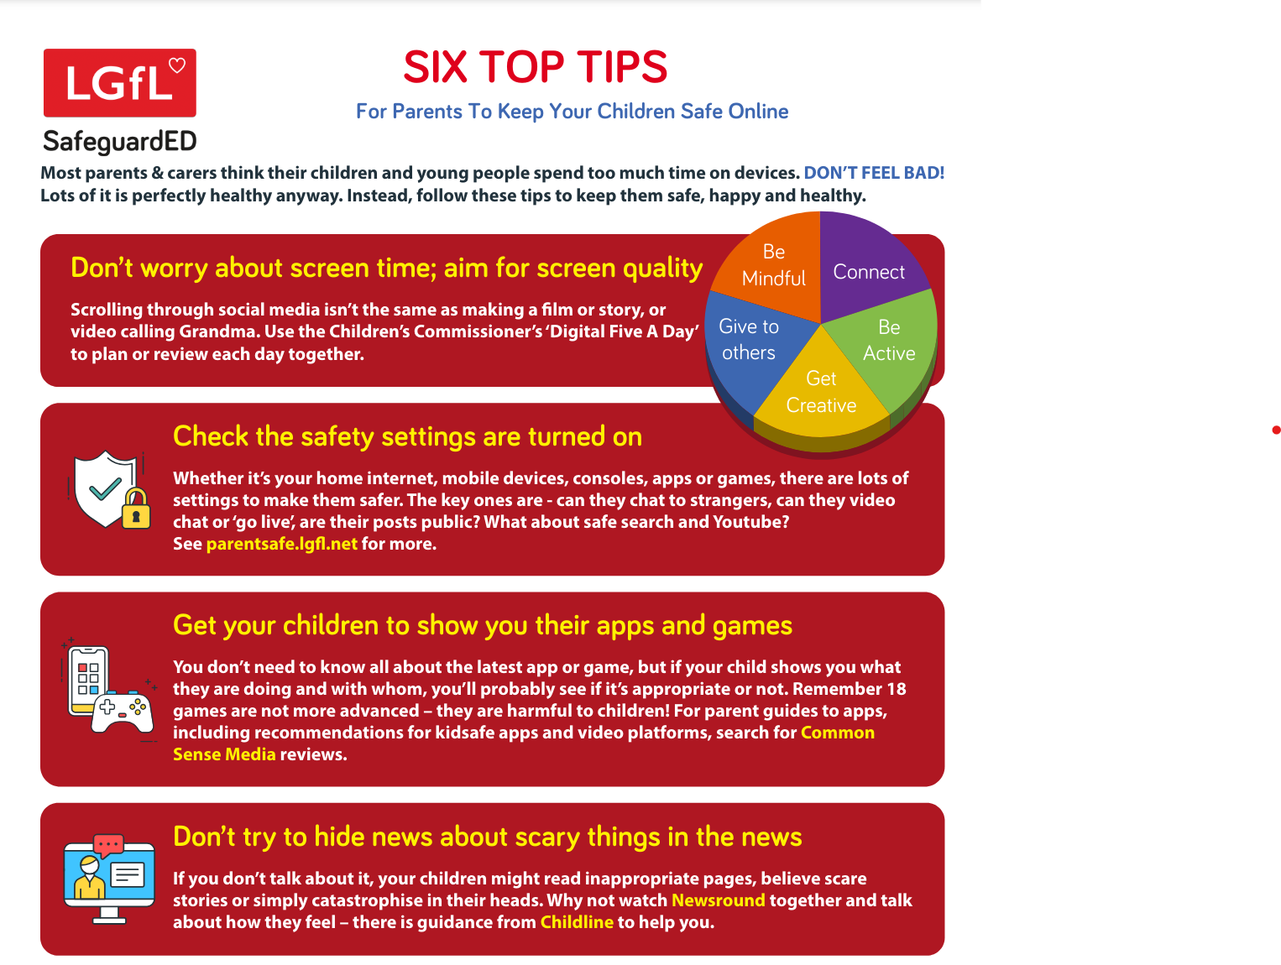
Notes:
TELL - why not put this fridge-friendly poster on your fridge?

Slide 58
Why not have a family agreement to:
clarify what is allowed...or not
establish ground rules like no phones at the table or in the bedroom at night-time
agree shared expectations to reduce arguments and keep everyone safe & healthy
Download it at parentsafe.lgfl.net/digital-family-agreement
Notes:
TELL - LGfL have a free template of a digital family agreement that parents could sit down and populate with all family members to agree what is and is not allowed within their family around tech use. This includes parents! We need to role model good behaviour.
ASK – Can you think of any examples of how we as parents can model good behaviour?

Slide 59
Where to get help?
Child/rens class teacher
Miss Ray – Headteacher / safeguarding lead
Mrs Twyford – computing lead / deputy head / deputy safeguarding lead
Notes:
Please amend this slide with anything further you want to tell parents about reporting concerns to the school and seeking help

