Slide 1
Reading & Phonics in Reception
27th September 2022

Slide 2
Reading for Pleasure
At Caversham Park Primary School we aim to instil a love of reading and ensure your child learns to read well. Numerous research projects have found that the more a child reads the better reader they will be. So regular reading at home is paramount!

Slide 3
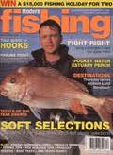

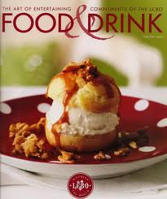
Reading for pleasure ☺
Reading comes in many forms......
Signs
Labels
Comics
Nursery Rhymes
Catalogues
Magazines

Slide 4
Parents and Families
Your most important role should be in teaching children that reading is fun and will support their other interests, and is not just a "skill" that must be learned in order to do well at school or get a good job.
Research has shown that children’s literacy levels rise substantially when parents, especially male role models, are involved in reading.

Slide 5
How do we teach reading in Reception?
Books with no words
Essential start to reading together.
No pressure to be right or wrong.
Learning story language.
Learning story structure.
Talking through what has happened and how you know.
Asking and answering questions.

Slide 6
Reading books with no words
Start by looking at the front cover and asking your child what they can see and what the story may be about.
Encourage your child to hold the book correctly and turn the pages independently.
Support your child to describe what is happening on each page. If they are not sure they can tell you what they can see.
Introduce new vocabulary

Slide 7
Reading books with no words
Encourage and support your child to use story language, e.g. once upon a time; next; later.
Ask them to make predictions
Talk about how the characters are feeling and explain why they feel like this.
Encourage children to speak in full sentences.
Ask questions to support understanding (often some at the back of the book). Use a range of question types: who, what, when, where, why, how.
Relate the story to children’s own experiences.

Slide 8
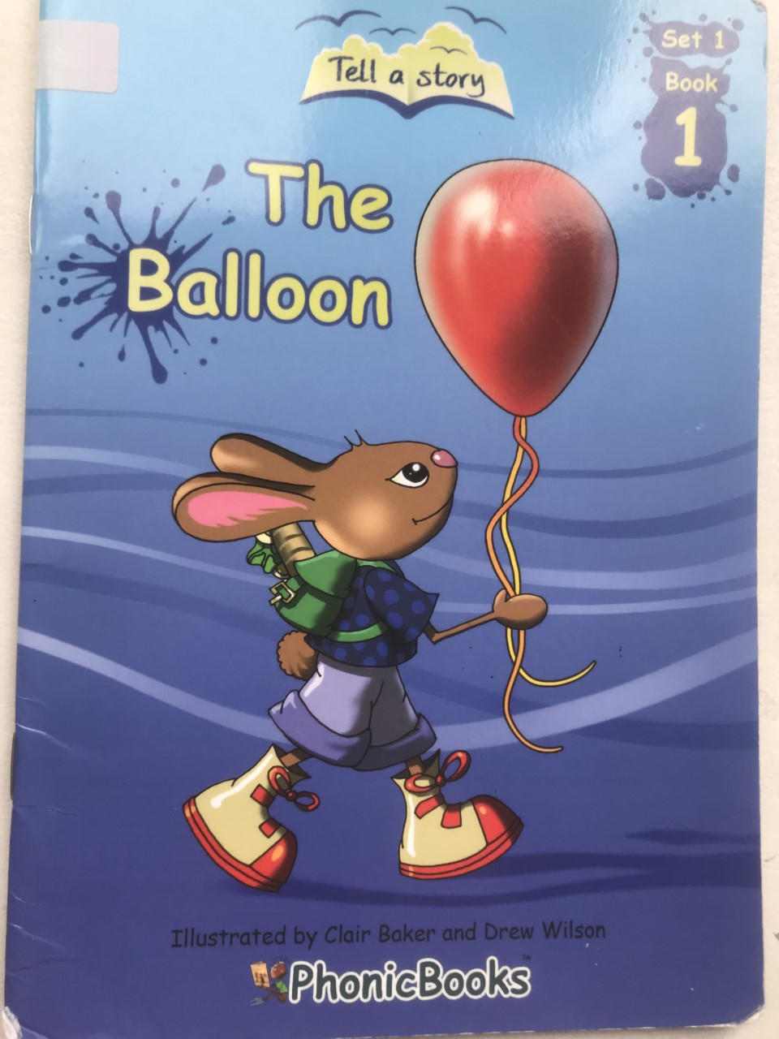

Slide 9
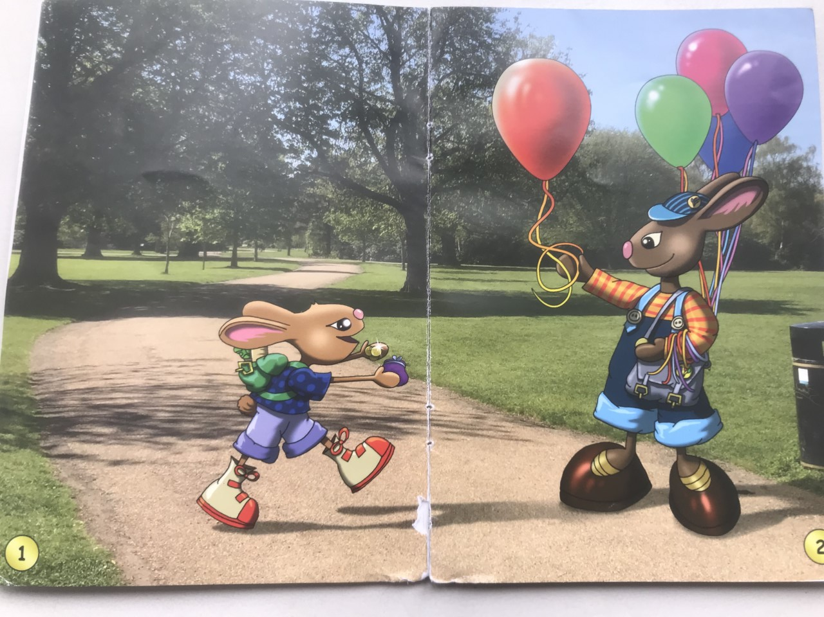

Slide 10
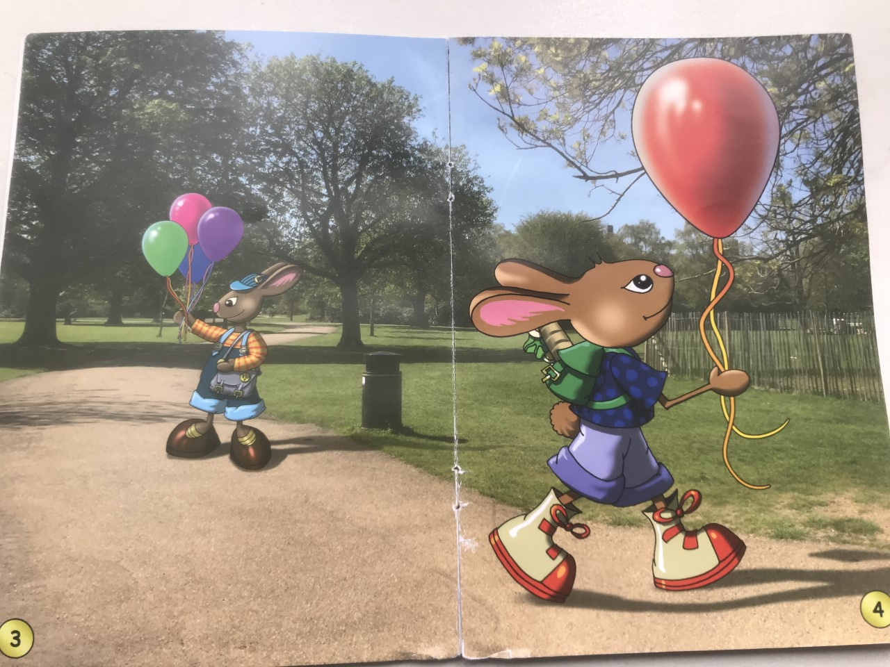

Slide 11
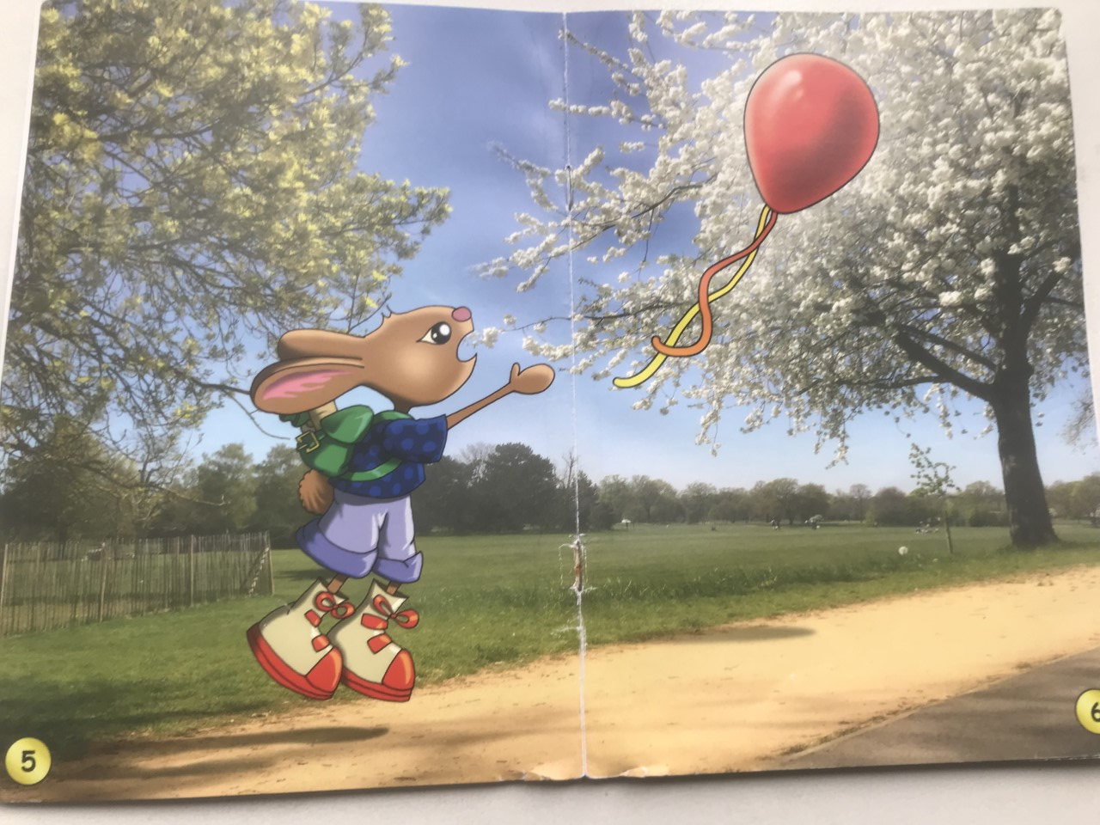

Slide 12
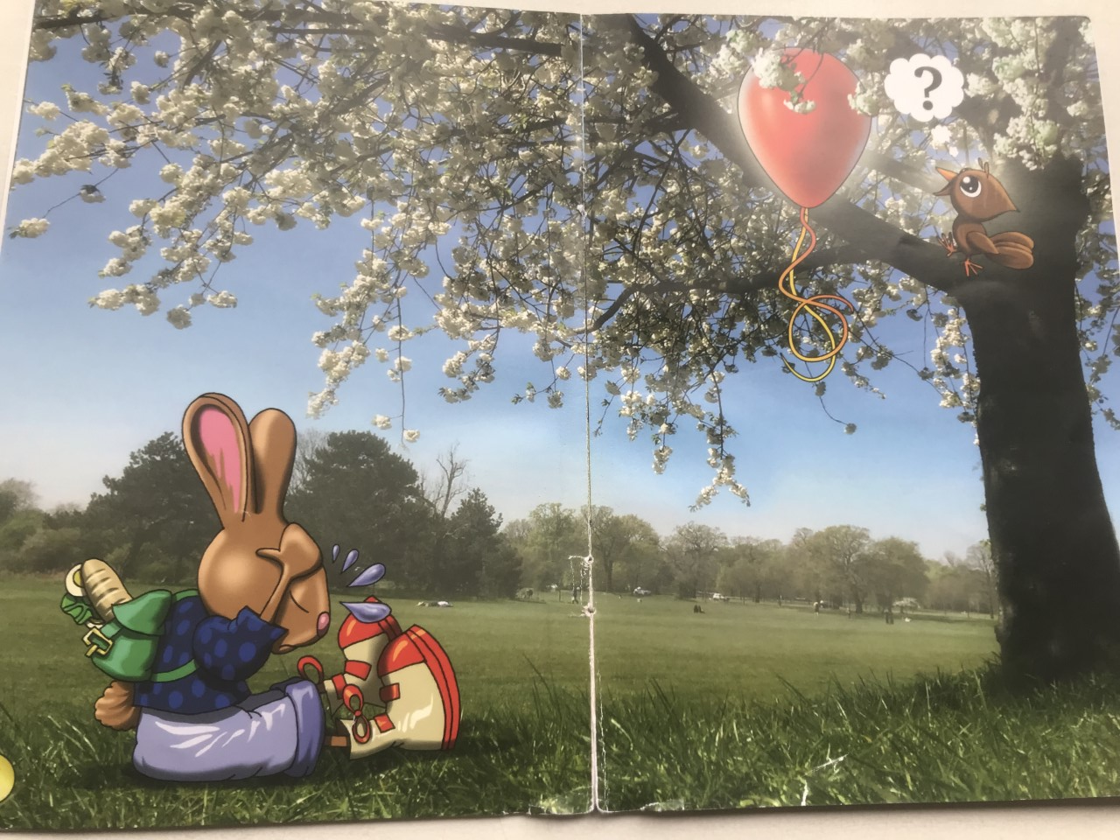

Slide 13
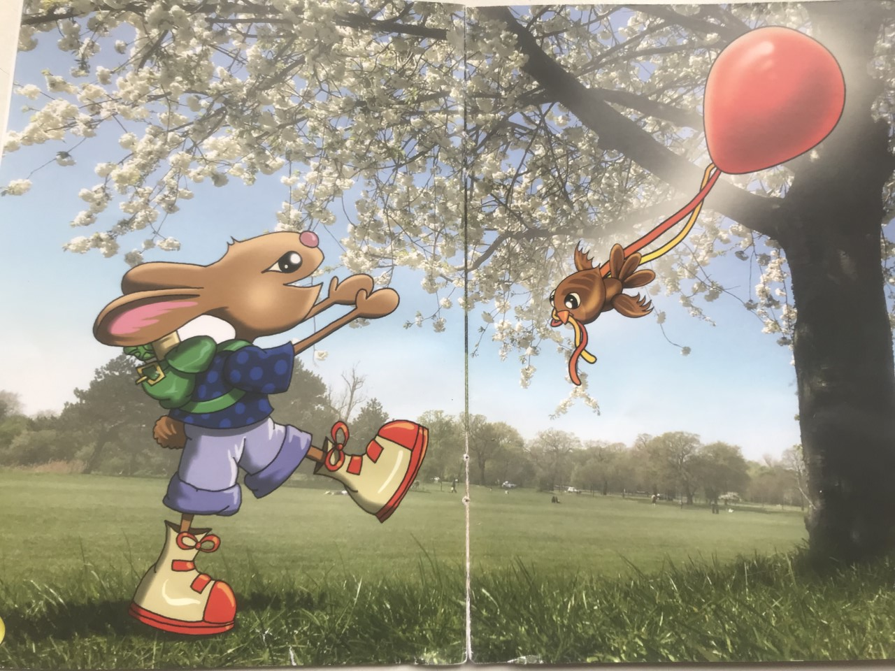

Slide 15
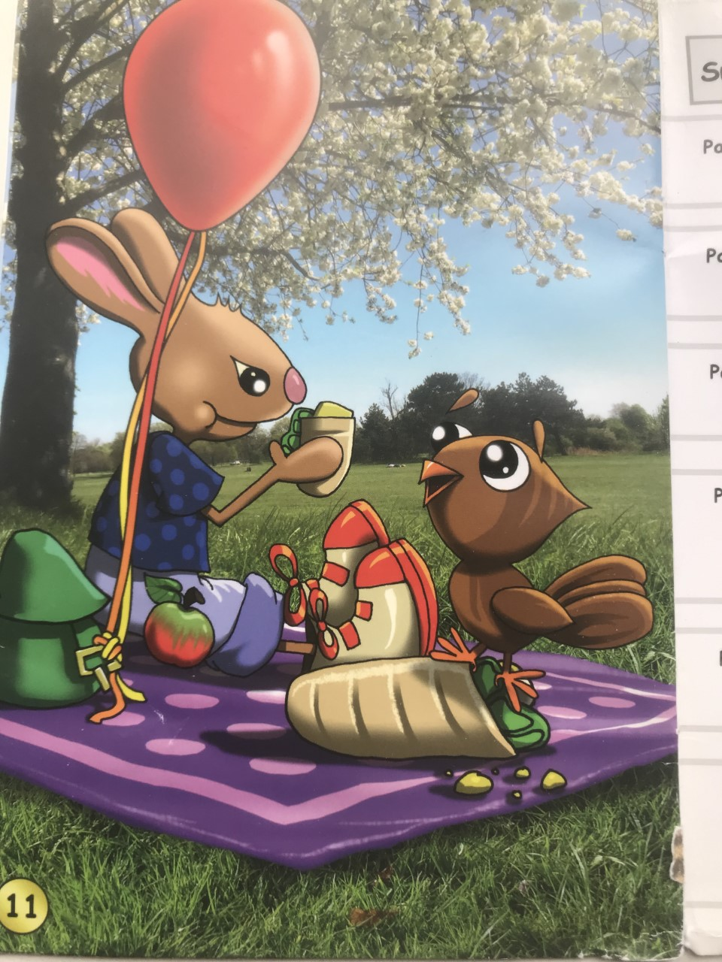

Slide 16
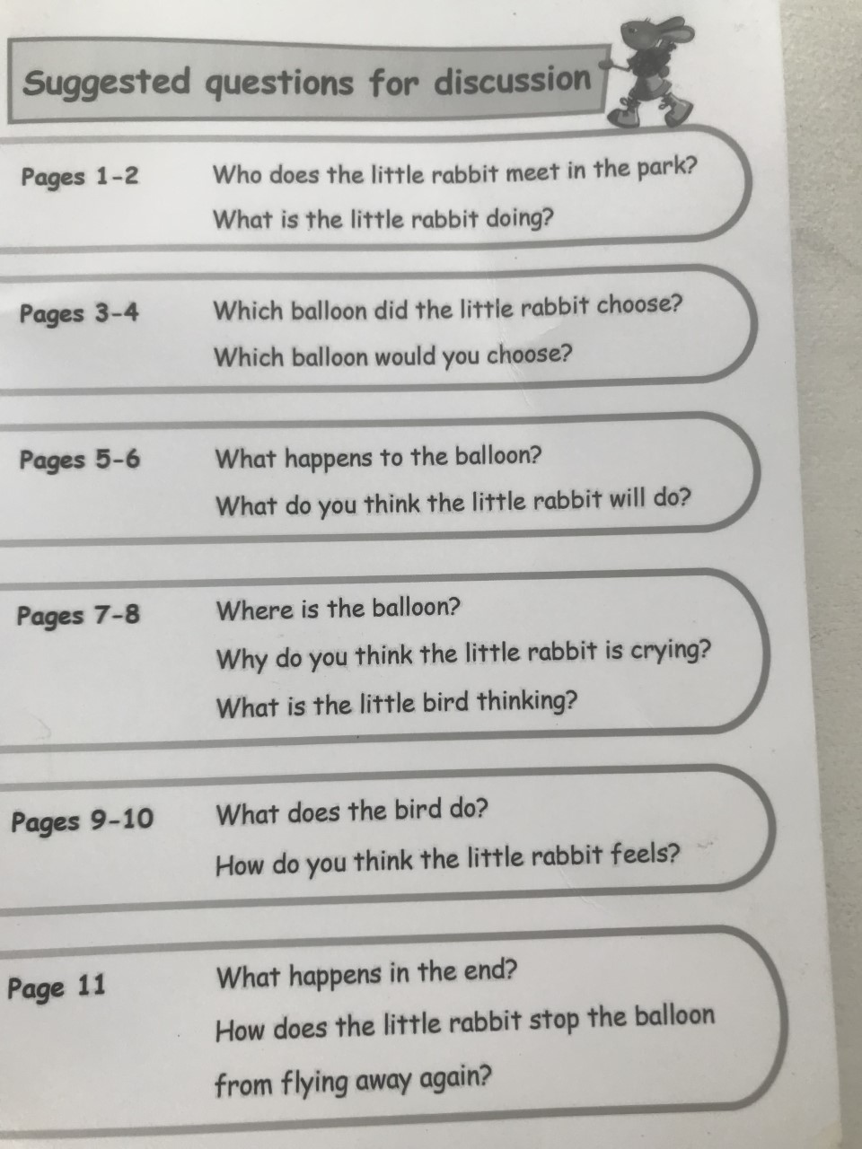

Slide 17
Phonics
Phonics is the relationship between letters and spoken sounds.
It teaches the children to read and write. It is the main form of teaching reading, writing and spelling in school.
Phonics is taught daily in school – 20 minutes a day. We start at a brisk pace and may slow down once the children know the first set of sounds.

Slide 18
Phonics
By using the sounds the children are able to read words even if they don’t know what they say…
Wigh ar wea dueing thiss?
Ie feall sstewppide!

Slide 19
Phonics
Focus on using the sounds of letters not letter names
No uh on the end of the sound
  Duh- oh- guh vs. d-o-g.
Children read words by blending the sounds together.
Phonics does not work with some words – we call these ‘tricky’ words.
Once children confidently know at least half the sounds and can blend them to make a word, they will have books with words.

Slide 20
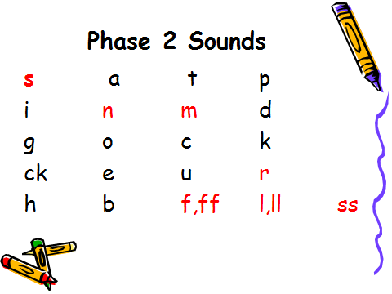
Click here to hear pronunciations.

Slide 21
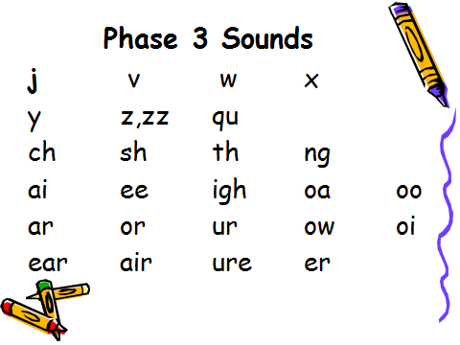

Slide 22
Other Phases
Phase 1 is all about listening and playing with sounds. Children begin to oral blend e.g. I say d…o…g, you say… They will have done this at Nursery/Pre-school and we continue to play these games throughout Reception.
Phase 4 – applying phase 2 & 3 sounds to read and write longer words – e.g. spot, crank, pondweed.
Phase 5 – some children may begin this in Reception but it is mostly taught throughout the whole of Y1. In this phase the children begin to learn the alternative ways of making the sounds they already know, e.g. ai, ay, a_e, a, eigh.

Slide 23
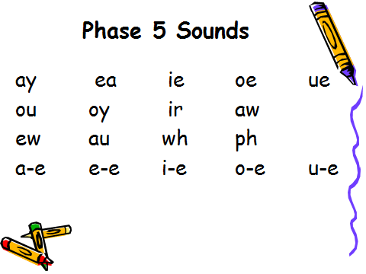

Slide 24
Phonics Actions
In order to support different learning styles we teach the children actions to go with each sound.
The children see a sound, make the sound and perform the action.
Please see separate sheet for actions.
Have a go at some!

Slide 25
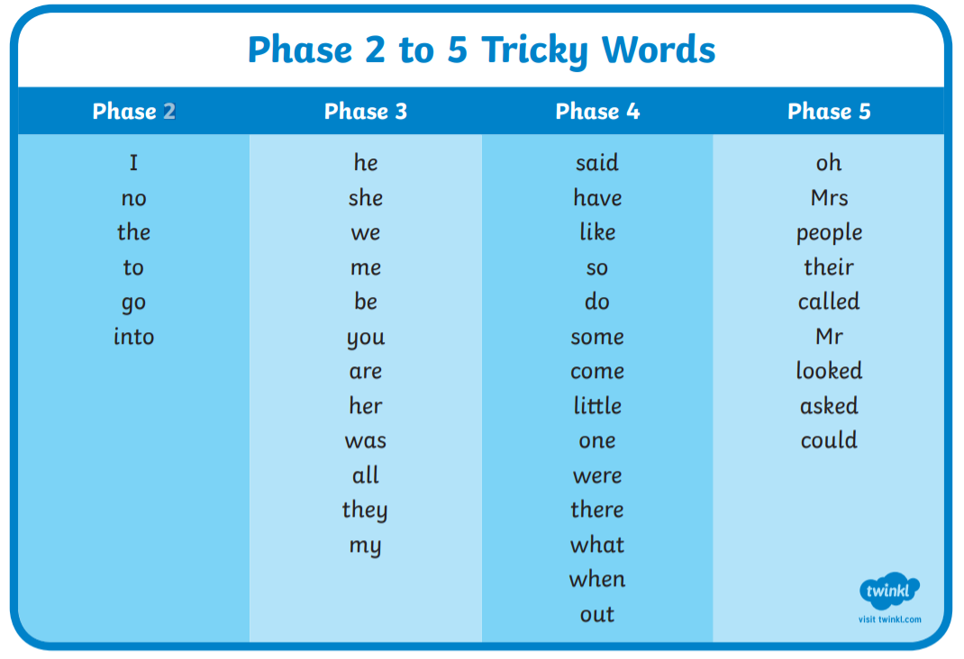

Slide 26
Beginning to read books with words
All our books are fully decodable and relative to the children’s current phonic phase.
Look at and discuss the front cover. Ask child to point to the title and read it together.
Ask the child to point to the words and say each of the sounds (unless a tricky word).
At first the child will not understand the difference between sounds, words and sentences and may need support in identifying when a word ends (if necessary cover other words).

Slide 27
They have a go at blending the sounds – encourage them to repeat the sounds quicker and quicker to see if they can hear the word.
If they cannot blend the word themselves then the adult says the sounds for child to blend, e.g. adult: c,a,t; child: cat!
If they still cannot hear it then the adult models the whole process (c,a,t-cat) and then over time the child will begin to hear it for themselves.
They will also find identifying tricky words and capital letters difficult to begin with.
Continue to ask questions, make predictions etc as with the non-word books.
There are usually activities in the back of the book you can do.
Target cards in reading records may also help you know what to work on.

Slide 28
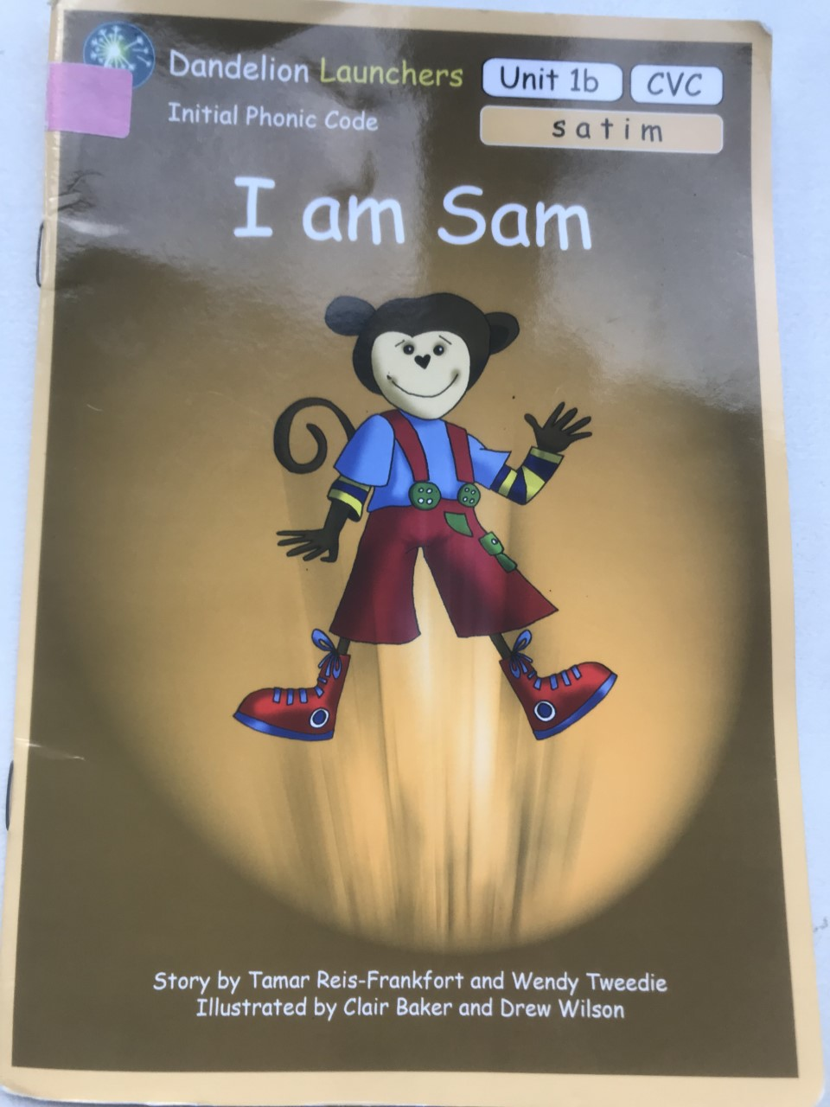

Slide 29
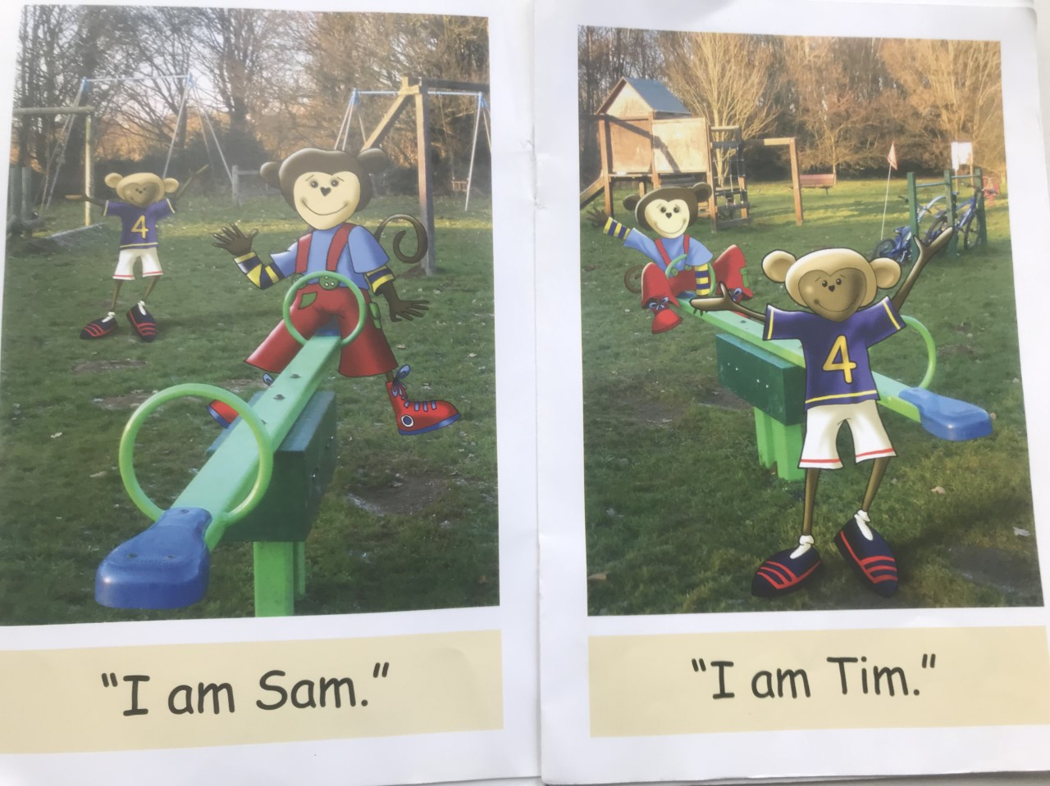

Slide 30
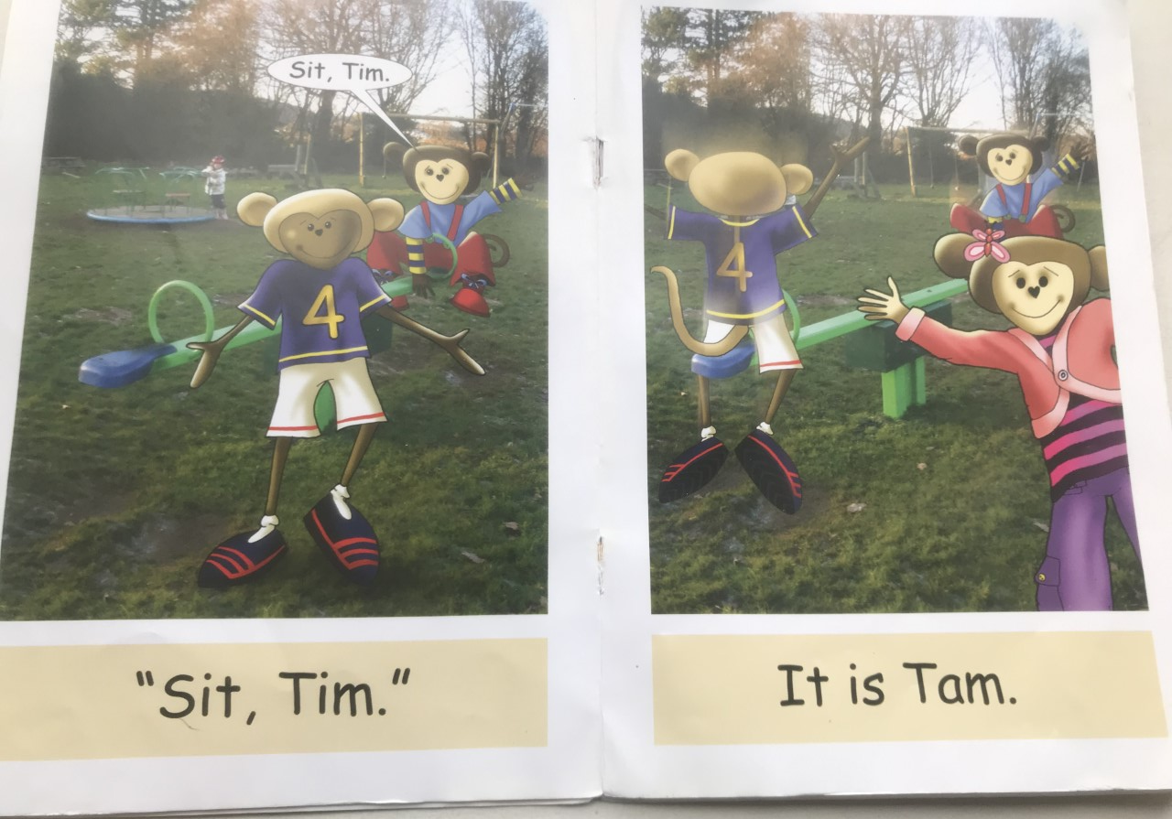

Slide 31
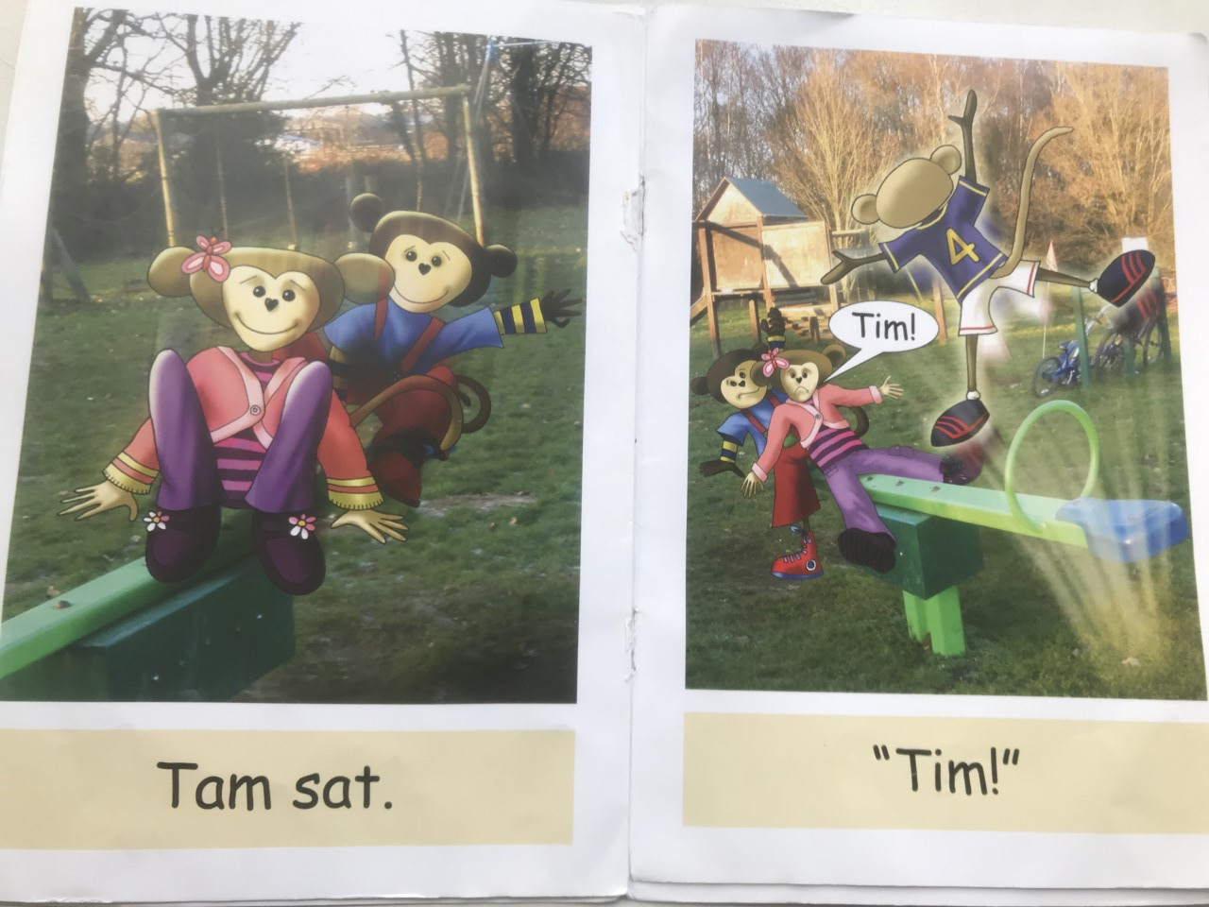

Slide 32
Importance of ‘Talk’
What is effective ‘book talk’?
Use the pictures (discussing/letting your child tell the story
Discussing the text (plot, characters, setting)
Sharing opinions (regarding both of the above)
Making predictions – what will happen next?
Giving reasons
Making links through real life experiences and other texts
In order for children to understand the context of books – they need to have had the opportunity to discuss and talk about their own real life experiences in order to make comparisons and relate.

Slide 33
Vocabulary
‘The more children read, the more words they’ll learn’.
Read to them
Get them reading
Use grown-up words in normal conversations
Encourage ‘book talk’ at home
Enjoy words- teach them ‘exciting’ tricky words and the word families they come from
Talk about synonyms (other words which mean the same) – For example: Which other words mean sad?

Slide 34

The key is…
Talk, talk and more talk!!
(often/ regularly/ frequently/everyday/all the time!)

Slide 35
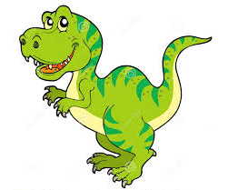
“Don’t be afraid to use big words with little kids. If they can say Tyrannosaurus Rex…
they can say anything!”

Slide 36
Reading books
Your child will bring home their first reading book today.
Reading books will be changed if it has been read at least 2 times.
The first read is for decoding and the second is for comprehension.
We also hear the children read regularly in school.
As stated previously all children will begin with books that contain no words – these are an important part of your child’s reading development.

Slide 37
Reading records
Your child will have a reading record along with their reading book.
When you have read with your child the record book must be filled out.
Any information about how your child has read is useful e.g. words/sounds they found tricky. How was their blending? Could they answer questions?
Positive comments please! ☺

Slide 38
Conclusions
Love reading & show this to your child
Remember reading comes in many different forms.
Use phonics!
Bedtime stories are a must- whatever your age!
Encourage the children to talk about what they have read.
Most importantly enjoy reading together!

Slide 39
Questions?

